Slide 1
SOGRO in Space
우주 기반 기초과학 워크숍(2020/12/04, 온라인)
Gungwon Kang (KISTI)
On behalf of Y.-B. Bae, W. Kim, C. Park, E. J. Son, J.J. Oh & S.H. Oh (NIMS)

Slide 2
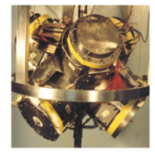
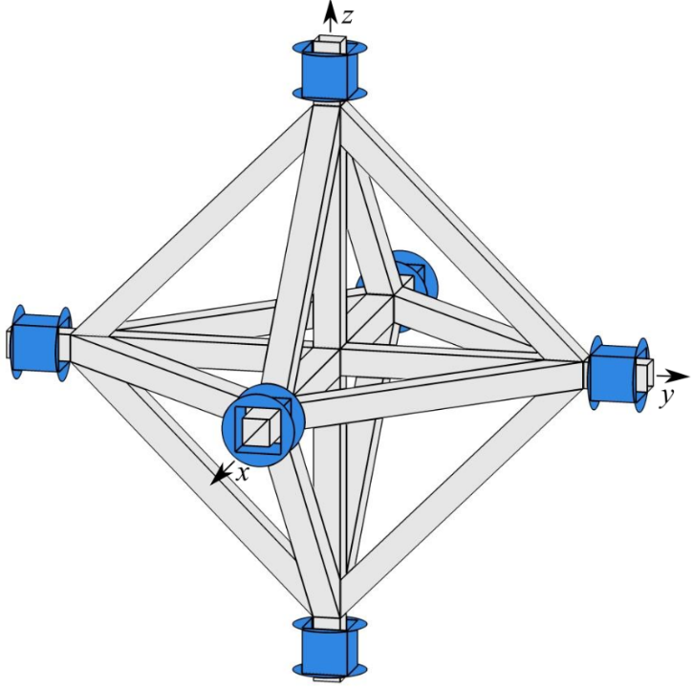
Background
SOGRO (Superconducting Omni-directional Gravitational Radiation Observatory):
  1979: Wagoner, Will & Paik ➔ 2016: Paik et al, “Low-frequency terrestrial tensor gravitational-wave detector,” CQG
  2017: KKN 3개 출연연 SOGRO 선행연구 수행
  국내(~15명) 및 U. of Maryland group (~5명): 개념연구 및 Science target 연구 수행 중
  초전도체 활용, 지상기반, 중 주파수대(0.1~10 Hz), 다채널 전방향 텐서 중력파 검출기
Moody, Paik, & Caravan (2002)
SOGRO/aSOGRO
pSOGRO
(30 m, 50 m, 100 m)
(100~250) tons
≤ 4 K
지하 ~200 m
2 m, 1 ton

Slide 3
(arXiv:1604.00439)
Seismic+Newtonian noises
Due to underground: (200~500) m
Newtonian noise cancellations using seismometers, microphones & tensor channels (Harms & Paik ’15)

Slide 4
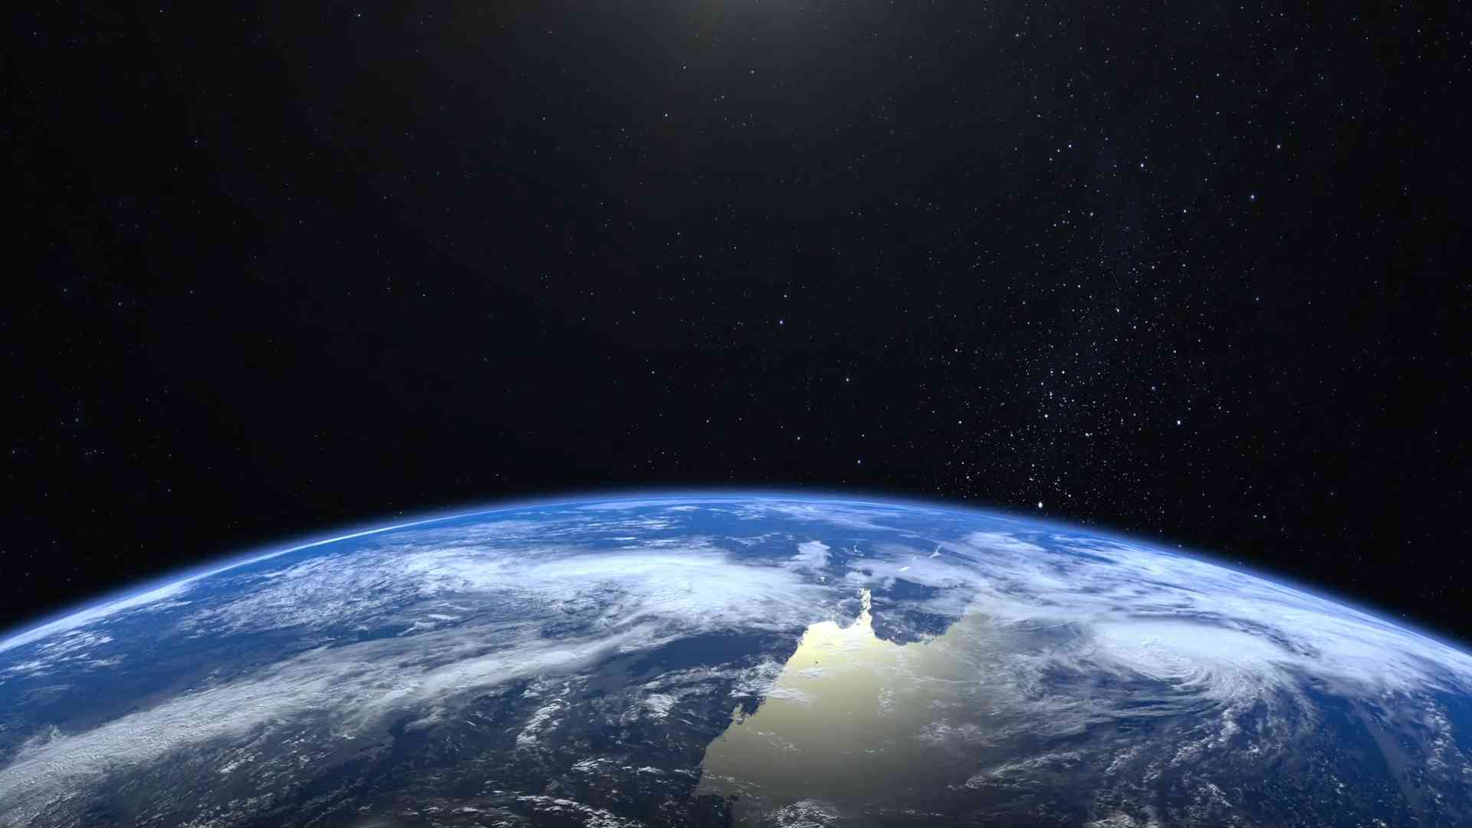
SOGRO in Space

Slide 5
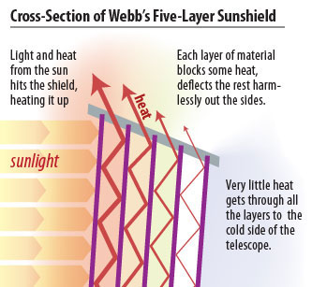
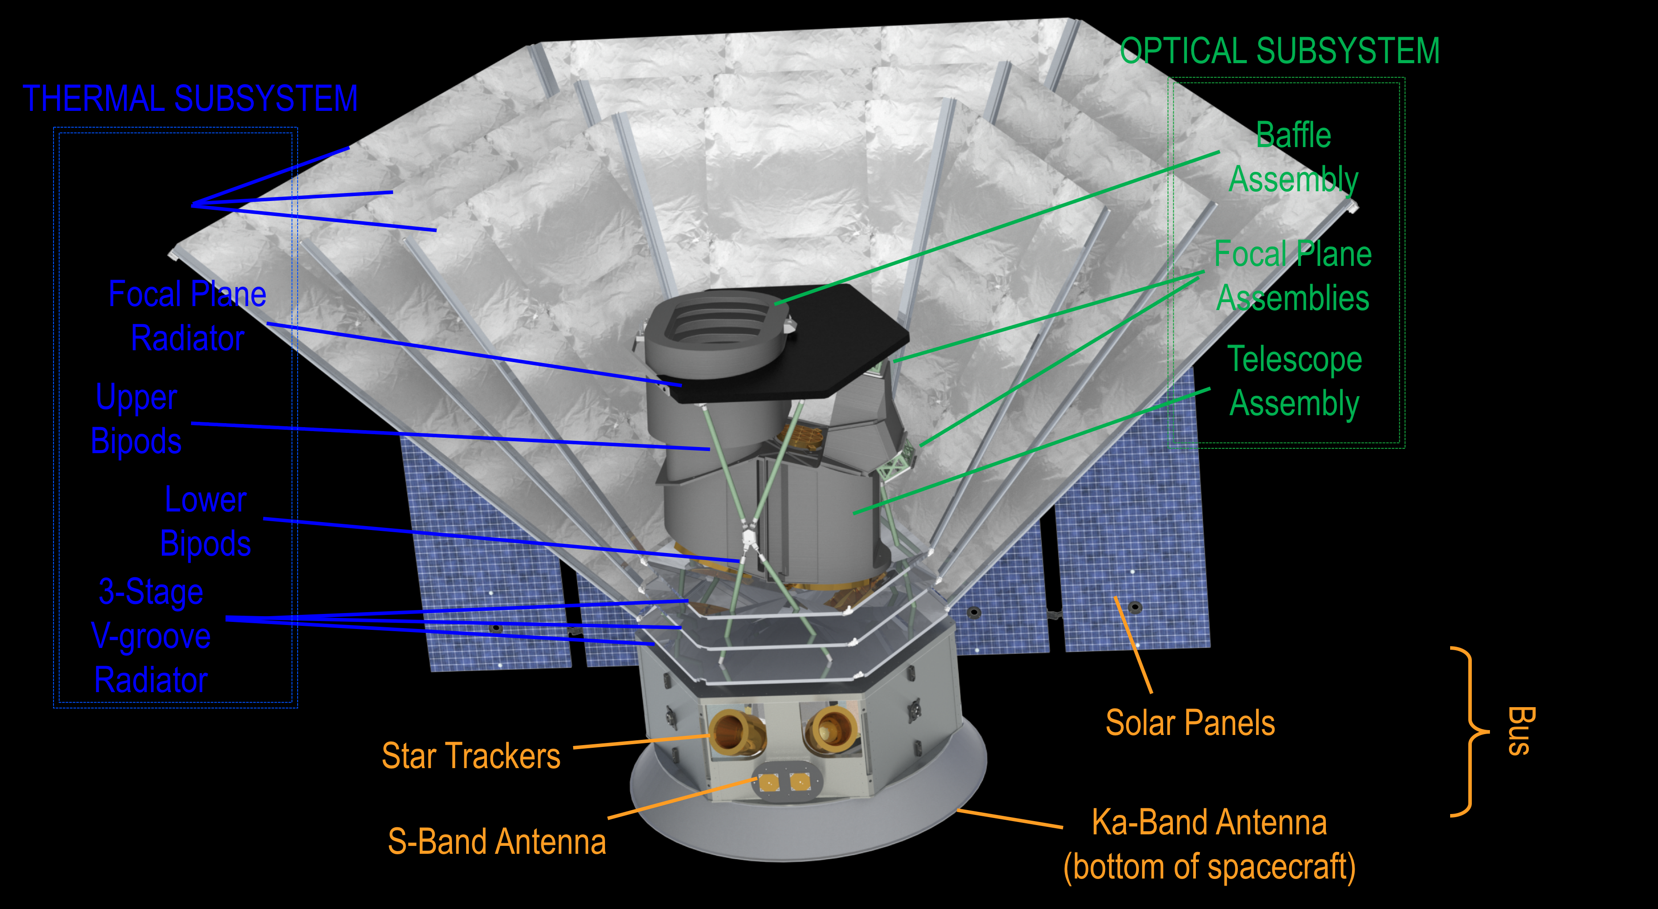
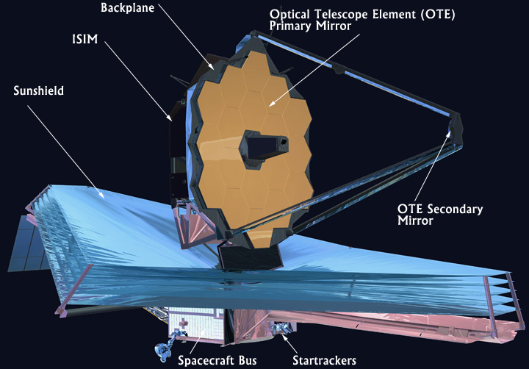

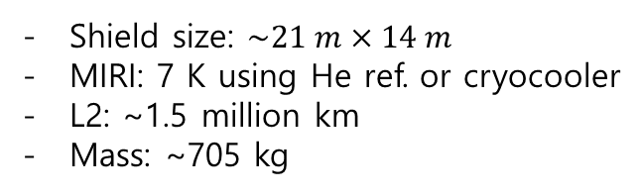
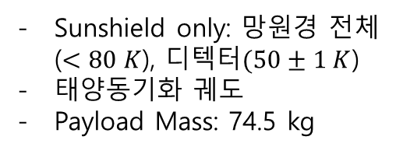
장점(PROS):
  - Free from Seismic+Newtonian noises
  No need to be underground
  No need to mitigate Newtonian noises
  Cooling down to 50 K by using sunshield layers alone
SPHEREx
JWST
Sunshield only: 망원경 전체($<80 K$), 디텍터$(50±1 K$)
태양동기화 궤도
Payload Mass: 74.5 kg
Shield size: $\sim 21 m×14 m$
MIRI: 7 K using He ref. or cryocooler
L2: ~1.5 million km
Mass: ~705 kg
$383 K → 36 K$
www.jwst.nasa.gov
https://spherex.caltech.edu/

Slide 6
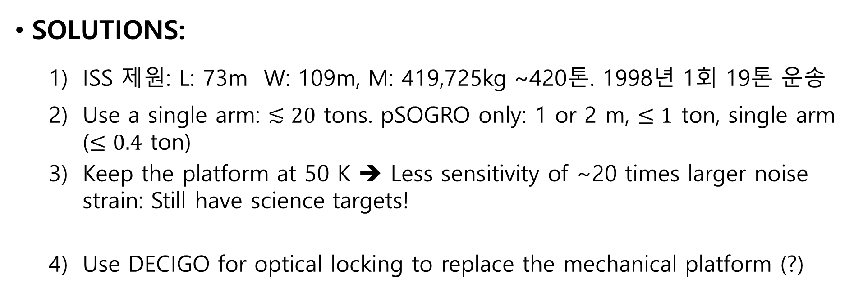
단점(CONS):
  Heavy mass: 100~250 tons, mainly due to platform, cryogenics & test masses
  Cooling ≤ 50 K: He dilution refrigerator
SOLUTIONS:
  ISS 제원: L: 73m W: 109m, M: 419,725kg ~420톤. 1998년 1회 19톤 운송
  Use a single arm: $≲20$ tons. pSOGRO only: 1 or 2 m, $≤1$ ton, single arm ($≤0.4$ ton)
  Keep the platform at 50 K ➔ Less sensitivity of ~20 times larger noise strain: Still have science targets!
  Use DECIGO for optical locking to replace the mechanical platform (?)

Slide 7

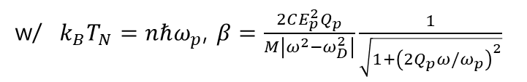
Sensitivity for $T=0.1K→50K, T_{pl}=4.2K→50K$:
$S_{h,xy}(f)=\frac{16}{ML^{2}ω^{4}}\left[\frac{k_{B}Tω_{D}}{Q_{D}}+\frac{\left|ω^{2}−ω_{D}^{2}\right|}{ω_{p}}{\left(1+\frac{1}{β^{2}}\right)}^{1/2}k_{B}T_{N}\right]$, $S_{ξ}\left(f\right)=\frac{16}{L^{2}}\frac{4k_{B}T_{pl}ω_{pl}^{2}}{M_{pl}ωQ_{pl}}\frac{1}{{\left(ω_{pl}^{2}−ω^{2}\right)}^{2}−{\left(ω_{pl}^{2}/Q_{pl}\right)}^{2}}$
w/ $k_{B}T_{N}=nℏω_{p}$, $β=\frac{2CE_{p}^{2}Q_{p}}{M\left|ω^{2}−ω_{D}^{2}\right|}\frac{1}{\sqrt{1+{\left(2Q_{p}ω/ω_{p}\right)}^{2}}}$
$\sqrt{S}\sim T^{1/2}→ {\left(\frac{50 K}{4.2 K}\right)}^{1/2}=3.5, {\left(\frac{50 K}{0.1 K}\right)}^{1/2}=22.4$
Less sensitivity, but still have good science targets!

Slide 8
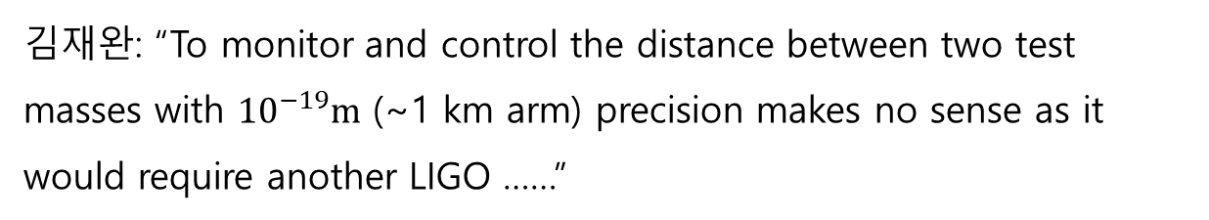
- Optical locking: Mechanical platform ➔ Optical rigid body
Laser
Actuator
Test Mass
Test Mass
Polarizer
Photodetector
Servo
김재완: “To monitor and control the distance between two test masses with ${10}^{−19}m$ (~1 km arm) precision makes no sense as it would require another LIGO ……”
(그림 출처: 김재완 ‘17)

Slide 9

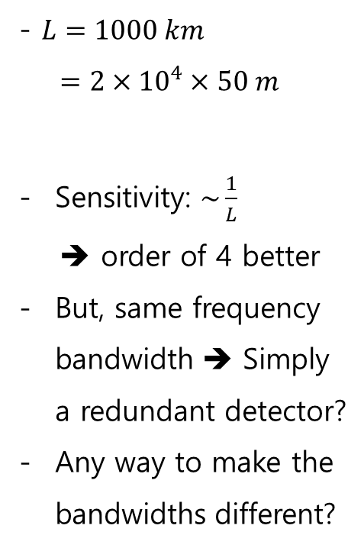
- $L=1000 km$
$=2×{10}^{4}×50 m$
Sensitivity: $\sim \frac{1}{L}$
➔ order of 4 better
But, same frequency bandwidth ➔ Simply a redundant detector?
Any way to make the bandwidths different?
(그림 출처: M. Ando ‘14)

Slide 10
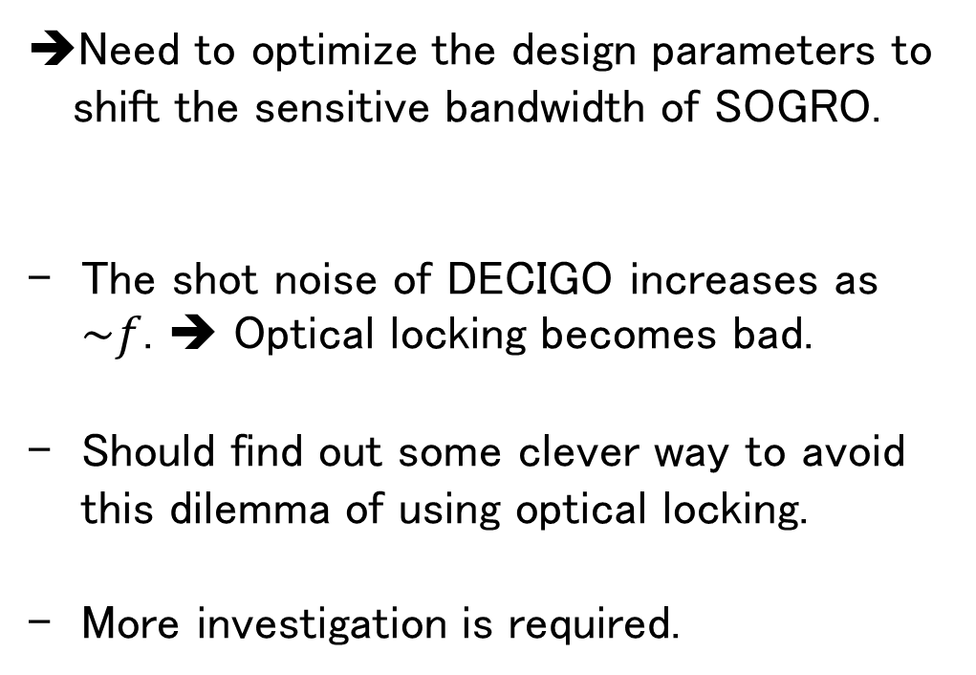


$S_{h,xy}(f)=\frac{16}{ML^{2}ω^{4}}\left[\frac{k_{B}Tω_{D}}{Q_{D}}+\frac{\left|ω^{2}−ω_{D}^{2}\right|}{ω_{p}}{\left(1+\frac{1}{β^{2}}\right)}^{1/2}k_{B}T_{N}\right]$, $S_{ξ}\left(f\right)=\frac{16}{L^{2}}\frac{4k_{B}T_{pl}ω_{pl}^{2}}{M_{pl}ωQ_{pl}}\frac{1}{{\left(ω_{pl}^{2}−ω^{2}\right)}^{2}−{\left(ω_{pl}^{2}/Q_{pl}\right)}^{2}}$
$$\sim \frac{1}{f^{4}}$$
$$\sim \frac{1}{ω^{4}}×ω^{5}\sim f$$
Need to optimize the design parameters to shift the sensitive bandwidth of SOGRO.
The shot noise of DECIGO increases as $\sim f$. ➔ Optical locking becomes bad.
Should find out some clever way to avoid this dilemma of using optical locking.
More investigation is required.
sSOGRO
그림 출처: M. Ando (’14)

Slide 11
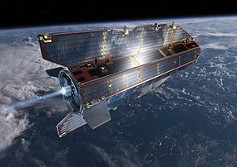
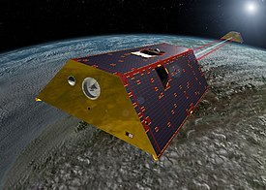


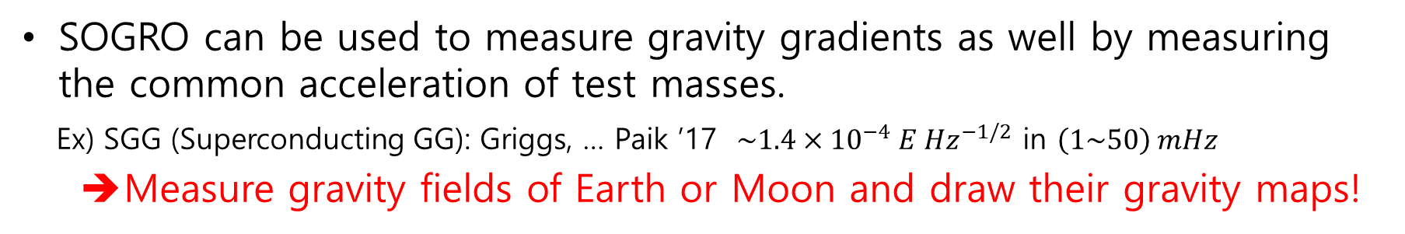

Gravity Gradiometer
SOGRO can be used to measure gravity gradients as well by measuring the common acceleration of test masses.
Ex) SGG (Superconducting GG): Griggs, … Paik ’17 $\sim 1.4×{10}^{−4} E {Hz}^{−1/2}$ in $\left(1\sim 50\right) mHz$
  Measure gravity fields of Earth or Moon and draw their gravity maps!
GOCE (Gravity Field and Steady-State Ocean Circulation Explorer)
GRACE (Gravity Recovery and Climate Experiment)
$∆g≤{10}^{−5} m/s^{2}$ , ~250 km
$${10}^{−17}$$
SGG
$${10}^{−18}$$
pSOGRO
그림 출처: Ampuero ‘18

Slide 12
결론
“지상기반 소그로 ➔ 우주기반 소그로”의 장단점을 살펴보고 그 가능성을 모색해 봄
“단축 소형 소그로”를 중력구배계(Gravity Gradiometry)로 활용한 저궤도 지구, 달 탐사 연구
“소그로”: 독창적 원리, 국내 제안, 미답지의 과학적 성과 담보

Slide 13
감사합니다!

Slide 14
예산
Lots of uncertainties, but one may get some hints based on
  2m Prototype SOGRO: ~370억원/6년
  지상 기반 50m SOGRO: (1000~3000)억원/10년
Space SOGRO: ……??

