Slide 1
NASA’s
2020 Decadal Survey Planning
2020 - 12 - 04
이재준 (천문전산융합센터/대형망원경사업단)
w/ 김재우, 선광일, 양성철, 양유진

Slide 2
Astro2020
Decadal Survey on Astronomy and Astrophysics 2020 (Astro2020)
Convened by the National Academies of Sciences, Engineering, and Medicine.
Charged to develop a comprehensive research strategy and vision for a decade of transformative science at the frontiers of astronomy and astrophysics.
The goal remains to deliver the report in Spring 2021.

Slide 3
Astro2020
Will prioritize science themes
Call for Science White papers
572 white papers received
And will prioritize missions
Call for Activities, Projects, or State of the Profession Consideration (APC)
294 white papers received

Slide 4
Decadal Survey produces a prioritized list
Astro2010 (Space missions)
Wide-field Infrared Survey Telescope (Nancy Grace Roman Space Telescope)
Explorer Program
LISA (Gravitational Wave)
IXO (X-ray)
Astro2000 (Space missions)
James Webb Space Telescope

Slide 5
NASA’s 2020 Decadal Survey Planning
https://science.nasa.gov/astrophysics/2020-decadal-survey-planning
The page lists final reports from the NASA's 2020 Astrophysics Decadal Studies, both the Large and the Probes Mission Concept Studies, and other activities.
The reports represent the culmination of four years of intense work by the astrophysics community.

Slide 6
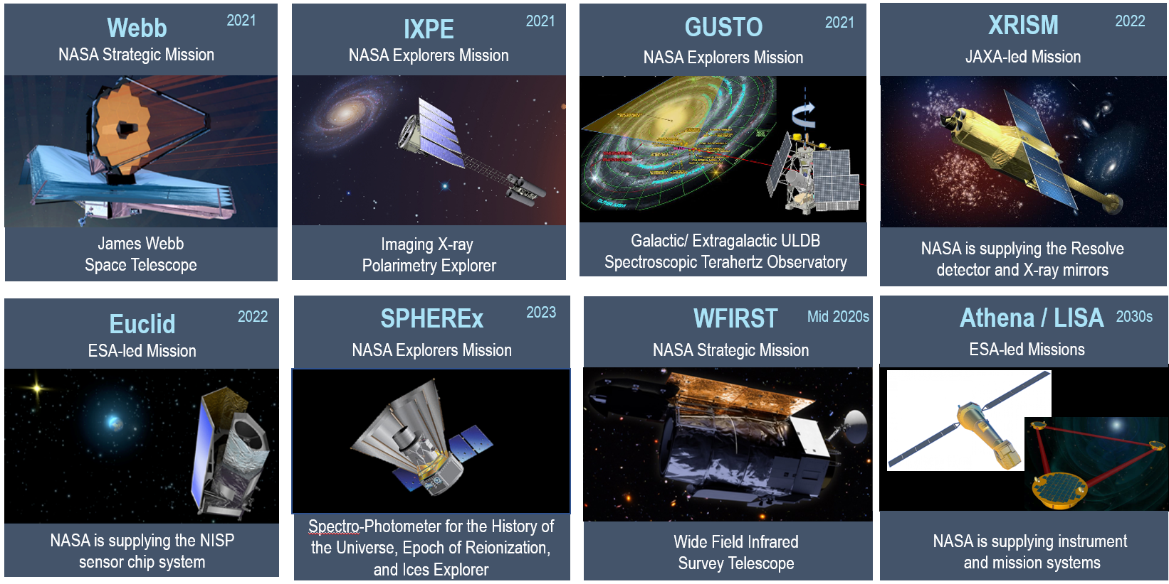
NASA’s Missions in Developments or Under Study
NASA’s astrophysics program
  Large (Flagship) missions, Medium (probe) & small (Explorer) missions

Slide 7
Astro2020 : NASA

Slide 8
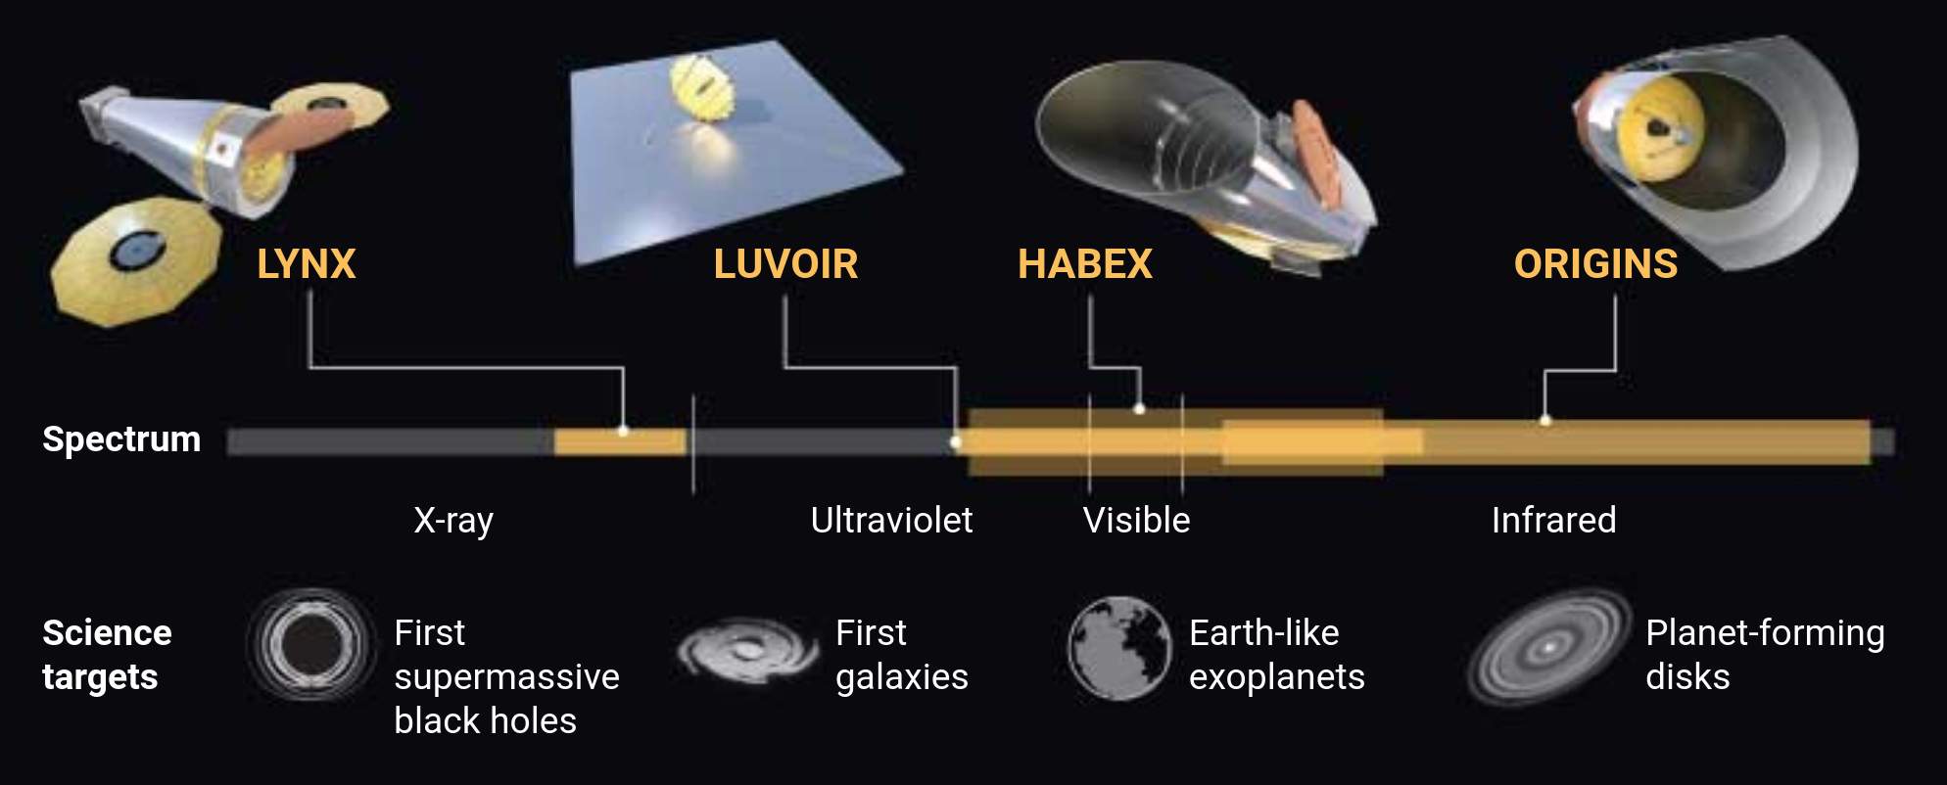
Four Large mission concepts
GW & CMP-pol surveyors are not proposed for Astro2020.

Slide 9
LYNX

Slide 10
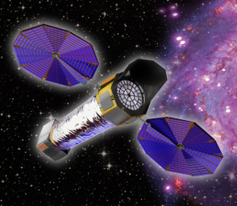
THE LYNX X-RAY OBSERVATORY
Lynx will provide leaps in capability over Chandra and Athena.
✕ ~100 gain in sensitivity
✕ 16 the field-of-view for sub-arcsecond imaging
high-resolution for both point-like and extended astrophysical targets.

Slide 11
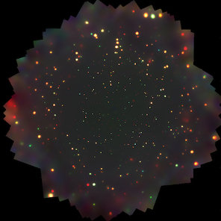
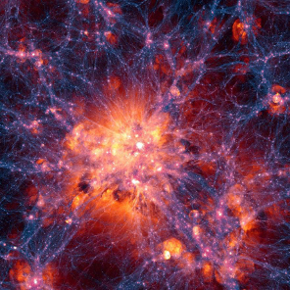
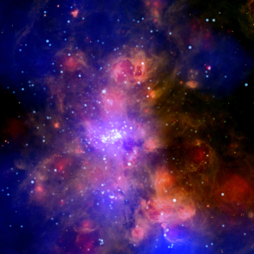
LYNX - Key Science
THE DAWN OF BLACK HOLES
THE INVISIBLE DRIVERS OF GALAXY FORMATION AND EVOLUTION
THE ENERGETIC SIDE OF STELLAR EVOLUTION AND STELLAR ECOSYSTEMS
To detect first massive black hole by observing X-ray from in the first galaxies
To map Kinematic & Chemical structure of hot galactic halos
To detect low-mass young stellar objects to 5 kpc.
To resolve the 3D structure of supernova remnants w/ Microcalorimeter

Slide 12
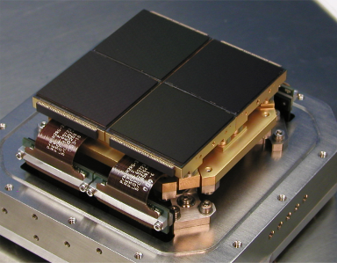
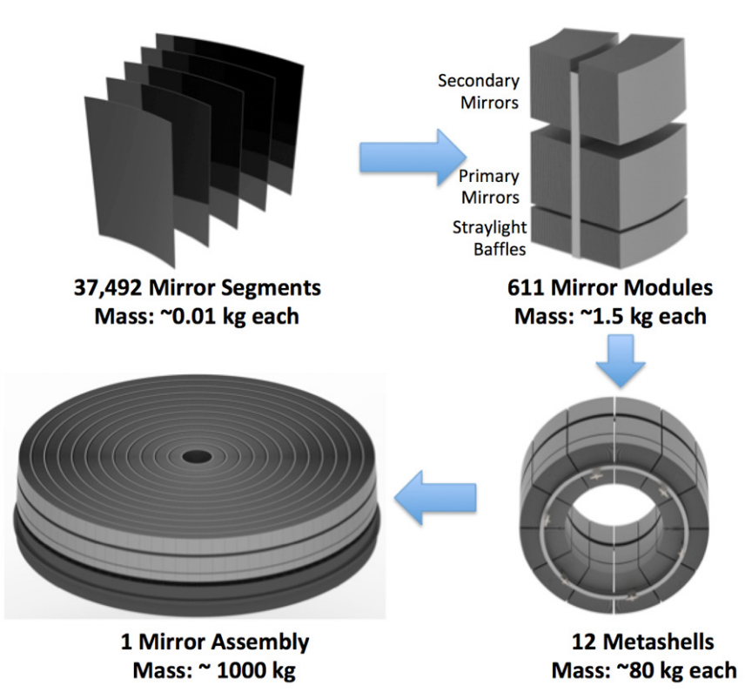
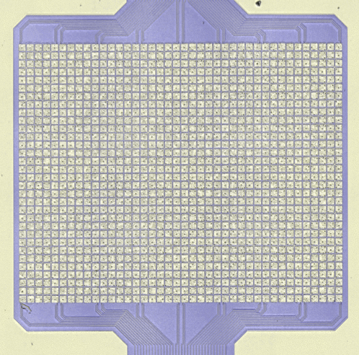
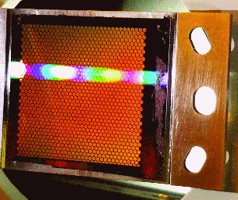
LYNX - Payload
Silicon Meta-Shell Optics
X-ray telescope
X-RAY MICROCALORIMETER
HIGH-DEFINITION X-RAY IMAGER
21 CMOS sensors
0.3” pixel
20'x20' FOV
0.1-10 keV w/ Δλ ~ 100 eV
1” pixel
5'x5' FOV
0.2-7 keV w/ Δλ ~ 3 eV (R~2000)
3 arrays that share the same readout
X-RAY GRATING SPECTROMETER
R > 5000
Several hundred higher throughput
Critical angle transmission grating

Slide 13
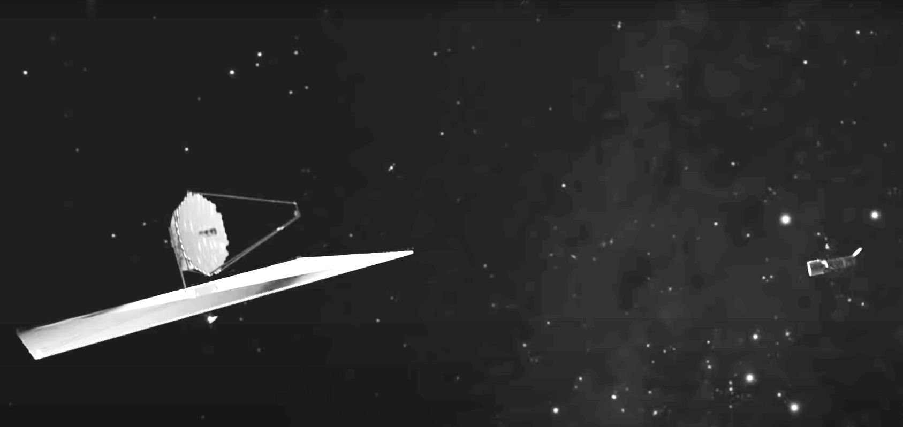
LUVOIR

Slide 14
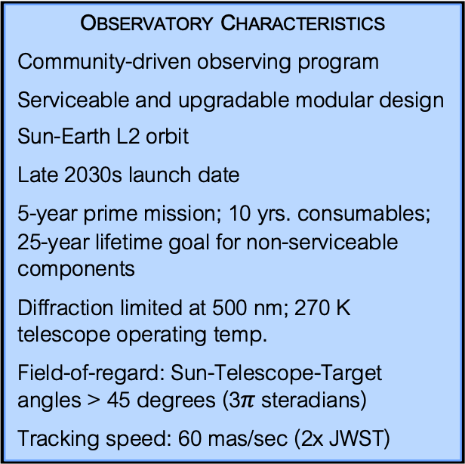
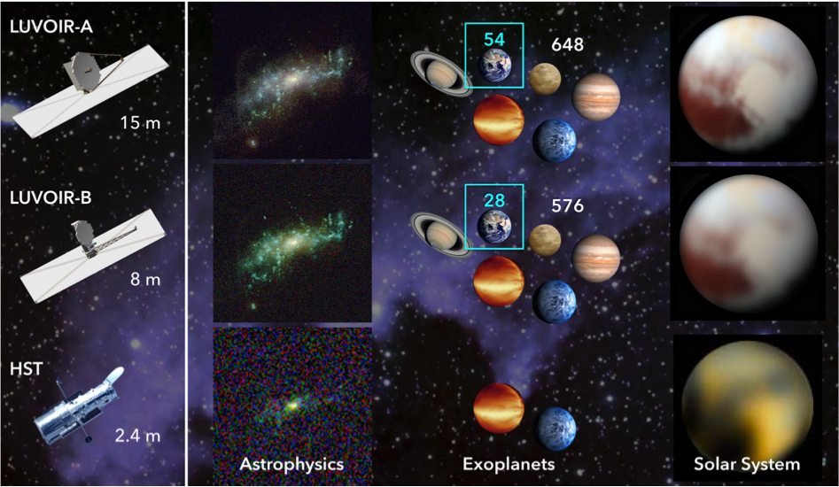
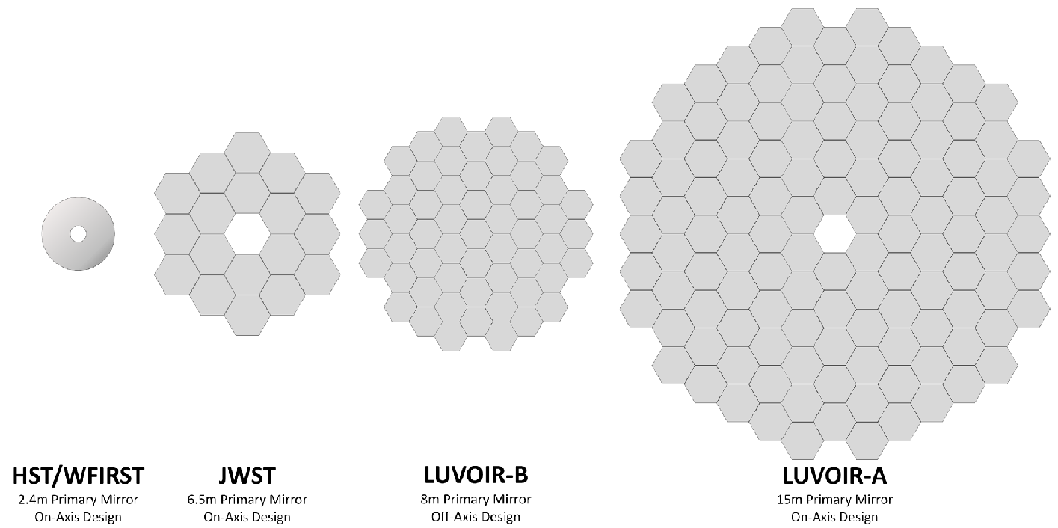
Large UV / Optical / Infrared Surveyor

Slide 15
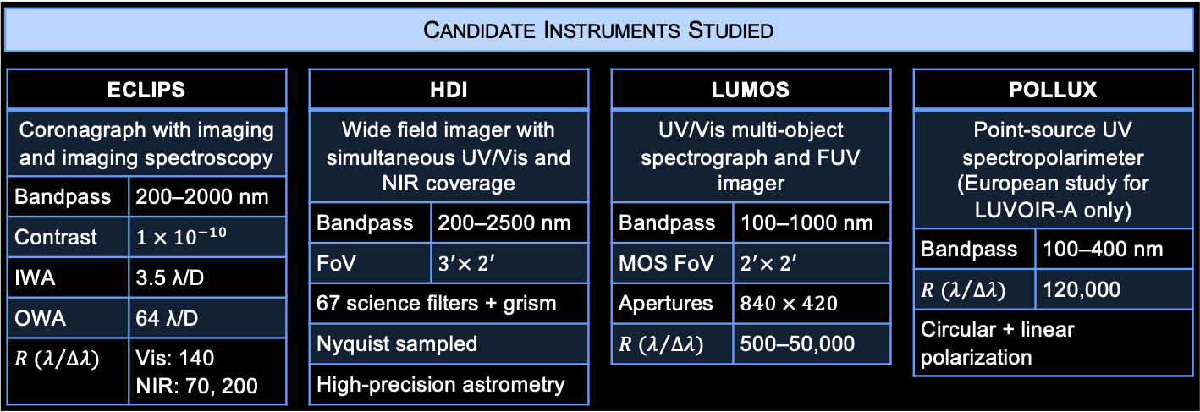
LUVOIR –Instruments & Sensitivity

Slide 16
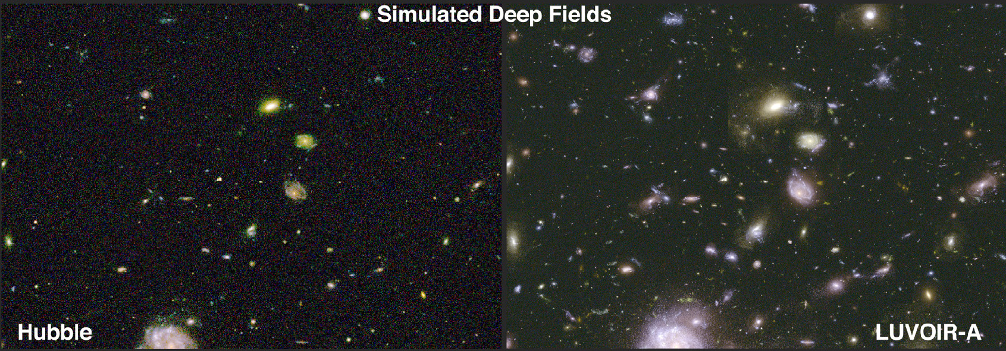
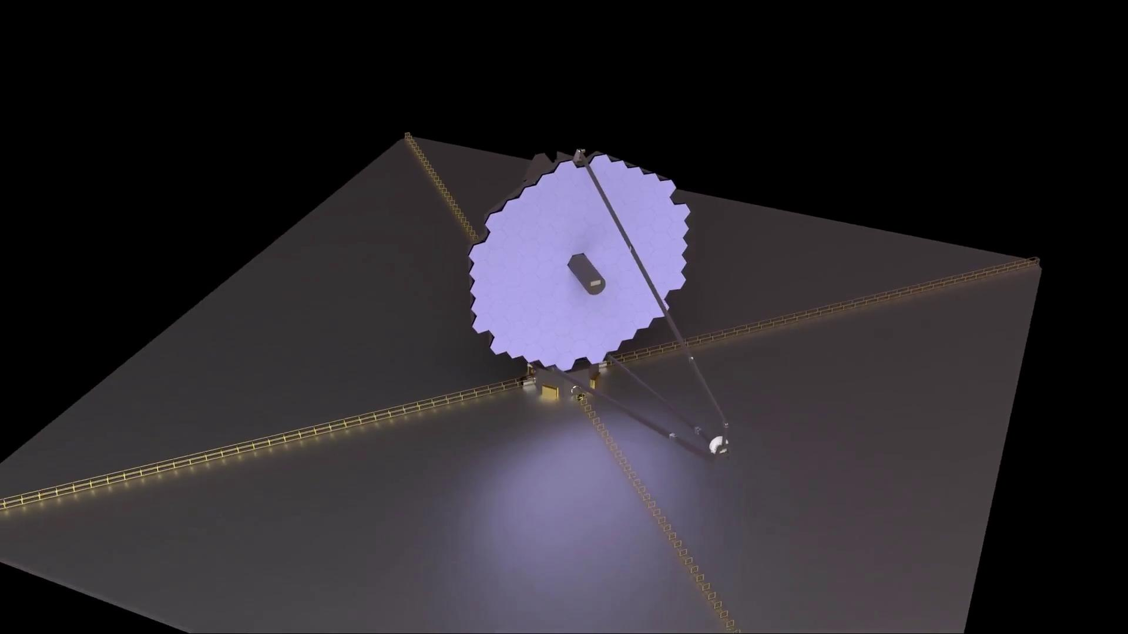
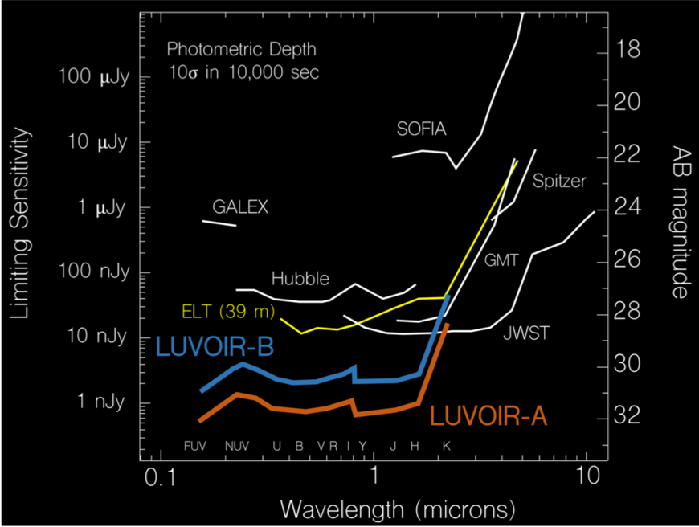

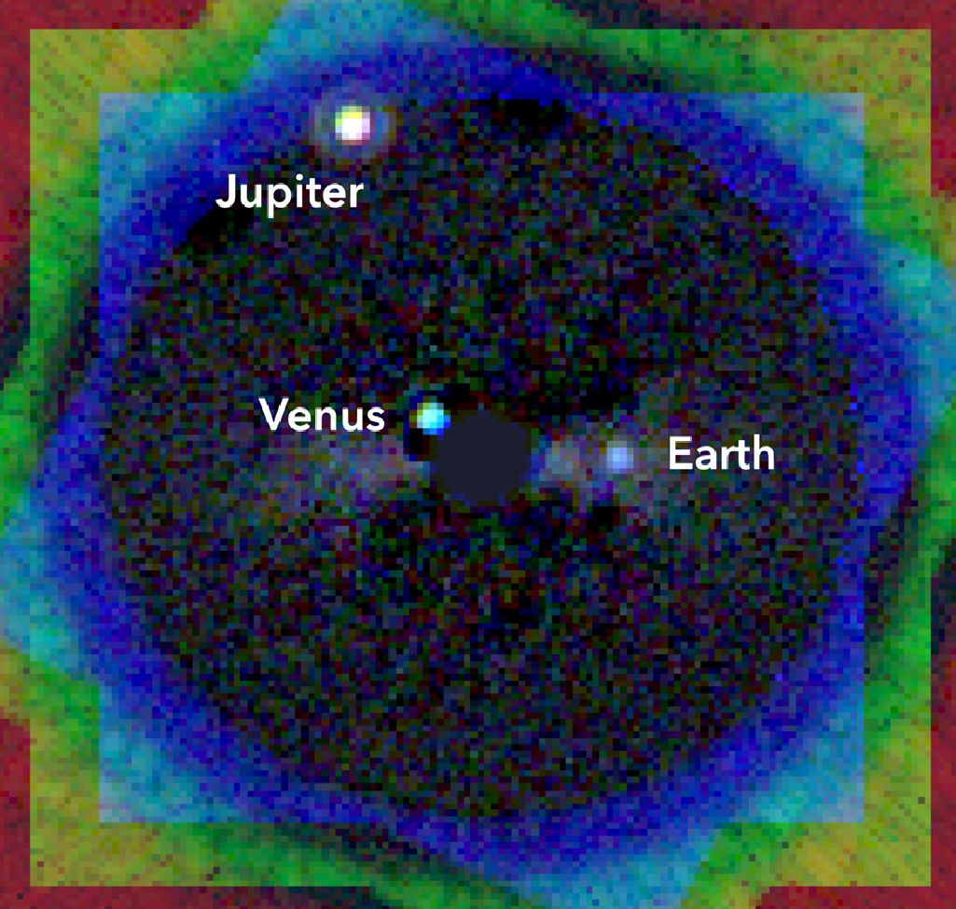
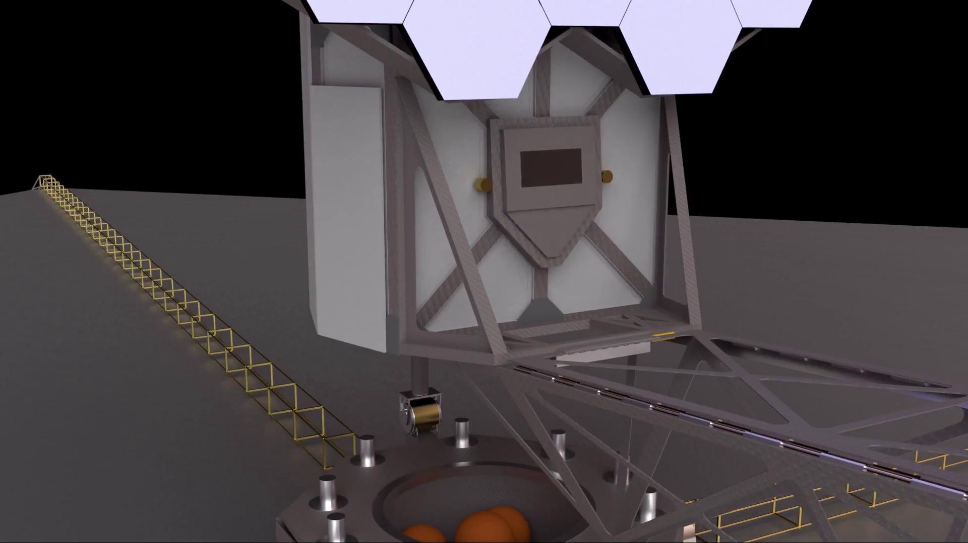
LUVOIR - Technical Challenge
Wavefront stability needed for high contrast
  An edge sensor and piezoelectric actuator control system.
  A laser metrology system
Sunshade deployment
  different from JWST; several advantages over JWST but with new challenges
Integration & Test
  Transportation : No single facility exists that is large enough to both integrate and test
  Vibration test : There is no know mechanical shaker in the world that would be able to shake
Returning the fully deployed LUVOIR to cis-lunar space for servincing at the Gateway??
THE STRUCTURE OF THE COSMOS (small-scale structure of dark matter)
MAGNETIC FIELD EVERYWHERE
THE HUNT FOR OTHER EARTHS AND LIFE
The Spatial Distribution of Low-Mass Dwarf Galaxies within 15 Mpc & the interiors of galaxies at z = 1-2.
High-precision astrometry for stars in dwarf spheroidal galaxies & resolved stellar populations in low-z galaxies
Tracing ionizing light over cosmic time
Finding Habitable Planet Candidates
Searching for Biosignatures and Confirming Habitability
Searching for Habitable Worlds in the Solar System (ocean moons)
High-resolution UV spectropolarimeter enables studies of a broad range of environments (explanets, AGNs, ISM, CGMs, Stars, Solar system)
Measurement of Linear polarization of UV absorption lines.
Direct Detection: Simulation of the inner solar system viewed from a distance of 12.5 parsec with 15-m LUVOIR-A

Slide 18
LUVOIR - Key Science
THE HUNT FOR OTHER EARTHS AND LIFE
Finding Habitable Planet Candidates
Searching for Biosignatures and Confirming Habitability
Searching for Habitable Worlds in the Solar System (ocean moons)
Direct Detection: Simulation of the inner solar system viewed from a distance of 12.5 parsec with 15-m LUVOIR-A

Slide 19
LUVOIR - Key Science
THE STRUCTURE OF THE COSMOS (small-scale structure of dark matter)
MAGNETIC FIELD EVERYWHERE
The Spatial Distribution of Low-Mass Dwarf Galaxies within 15 Mpc & the interiors of galaxies at z = 1-2.
High-precision astrometry for stars in dwarf spheroidal galaxies & resolved stellar populations in low-z galaxies
Tracing ionizing light over cosmic time
High-resolution UV spectropolarimeter enables studies of a broad range of environments (explanets, AGNs, ISM, CGMs, Stars, Solar system)
Measurement of Linear polarization of UV absorption lines.

Slide 20
LUVOIR - Technical Challenge
Wavefront stability needed for high contrast
  An edge sensor and piezoelectric actuator control system.
  A laser metrology system
Sunshade deployment
  different from JWST; several advantages over JWST but with new challenges
Integration & Test
  Transportation : No single facility exists that is large enough to both integrate and test
  Vibration test : There is no know mechanical shaker in the world that would be able to shake
Returning the fully deployed LUVOIR to cis-lunar space for servincing at the Gateway??

Slide 21
LUVOIR –Instruments & Sensitivity

Slide 22
LUVOIR – Technical Challenge?
Achieving the wavefront stability needed for high contrast direct observations of Earth-like (habitable) exoplanets using a large telescope.
An edge sensor and piezoelectric actuator control system.
A laser metrology system to measure the rigid body position of the secondary mirror relative to both primary mirror and the aft-optics system.
Sunshade deployment (different from JWST; several advantages over JWST but with new challenges)
Integration & Test
Transportation : No single facility exists that is large enough to both integrate and test as large as LUVOIR.
Vibration test : There is no know mechanical shaker in the world that would be able to shake LUVOIR-A (~37,400 kg for LUVOIR-A, 21,000 kg for LUVOIR-B).
Returning the fully deployed LUVOIR to cis-lunar space for servincing at the Gateway by some combination of astronauts and/or robots is a technical challenge, but not an impossible task.

Slide 25
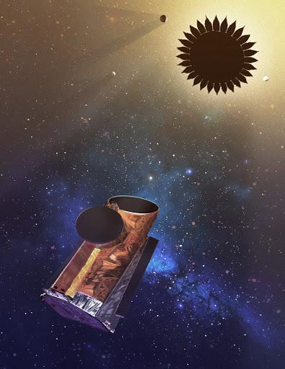
HabEx
50m starshade
76,600 km
@L2 orbit

Slide 26
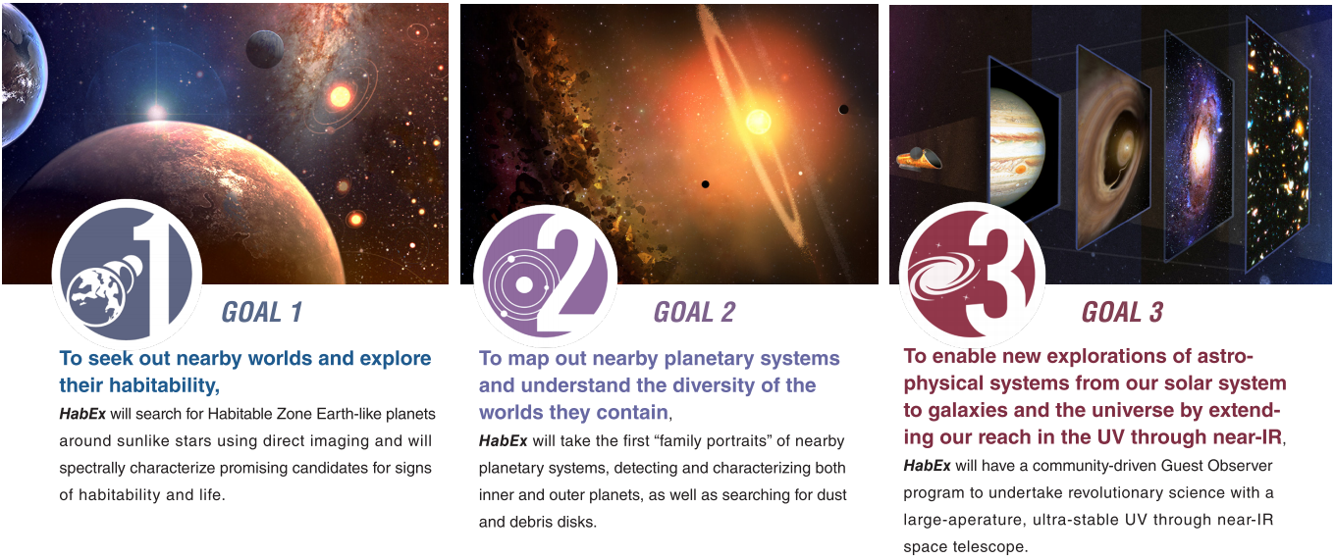
Habitable Exoplanet Observatory (HabEx)
HabEx, as a successor of Hubble Space Telescope (HST), is designed to be the Great Observatory of the 2030s capable of a broad range of science from UV through NIR.
25m starshade
76,600 km
@L2 orbit
Notes:
What is HabEx?
detecting and characterizing at least one rocky planet in the habitable zone of a sunlike star.
One of the four next-gen Flagship space telescope candidates (Large strategic science missions)
In 2016, NASA began considering four different space telescopes as the next Flagship (Large strategic science missions).^{[3]} They are the Habitable Exoplanet Imaging Mission (HabEx), Large Ultraviolet Optical Infrared Surveyor (LUVOIR), Origins Space Telescope, and Lynx X-ray Surveyor. In 2019, the four teams will turn their final reports over to the National Academy of Sciences, whose independent Decadal Survey committee advises NASA on which mission should take top priority. Selection is due to take place in 2021, and if selected, launch would be in approximately 2035.^{[3]}

Slide 27
Habitable Exoplanet Observatory (HabEx)
50m starshade
76,600 km
@L2 orbit
Notes:
What is HabEx?
detecting and characterizing at least one rocky planet in the habitable zone of a sunlike star.
One of the four next-gen Flagship space telescope candidates (Large strategic science missions)
In 2016, NASA began considering four different space telescopes as the next Flagship (Large strategic science missions).^{[3]} They are the Habitable Exoplanet Imaging Mission (HabEx), Large Ultraviolet Optical Infrared Surveyor (LUVOIR), Origins Space Telescope, and Lynx X-ray Surveyor. In 2019, the four teams will turn their final reports over to the National Academy of Sciences, whose independent Decadal Survey committee advises NASA on which mission should take top priority. Selection is due to take place in 2021, and if selected, launch would be in approximately 2035.^{[3]}

Slide 28
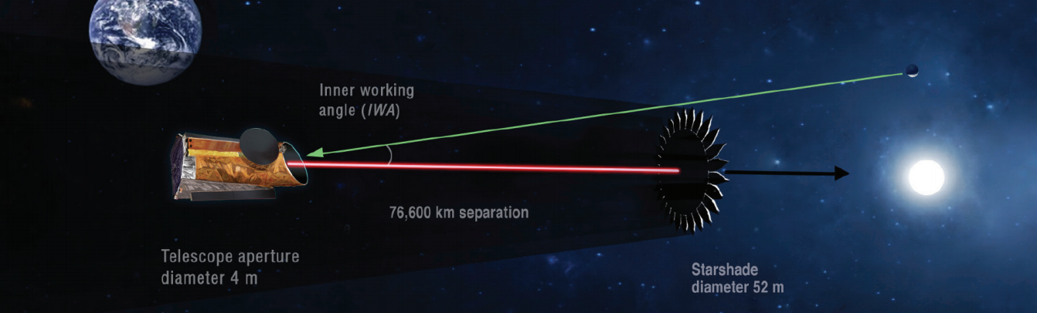
Habitable Exoplanet Observatory (HabEx) Spec
Notes:
Telescope Spec

Slide 29
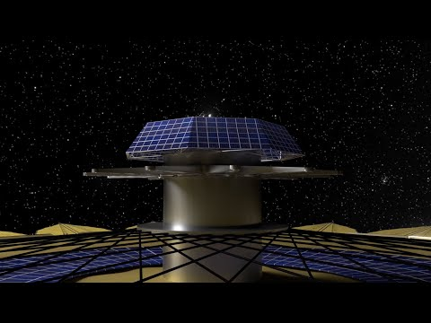
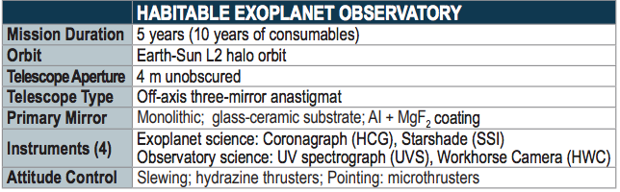
Habitable Exoplanet Observatory (HabEx) Science
Notes:
Telescope Spec

Slide 30
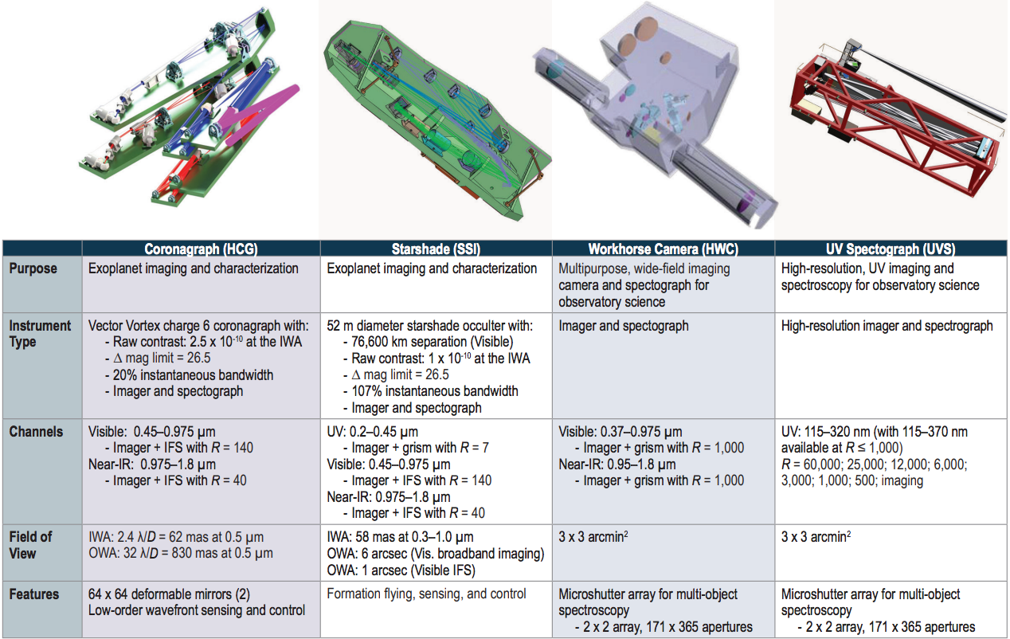
I
N
S
T
R
U
M
E
N
T
S

Slide 31
Habitable Exoplanet Observatory (HabEx) Mission Plan (proposed)
Mission Overview
Duration Launch date Rocket Programs Ability Highlight Expected Cost | 5-10 yr 2035 Observatory: Space Launch System (SLS) Block 1B Starshade: Falcon Heavy The first 5yr Primary mission: 50% of Key Sciences + 50% of Guest Observer (GO) The rest of mission: 100% GO programs including ToO 1000 times Contrast over HST $6.8B dollars FY2020 ($9.1B in real year dollar)

Slide 32
Origins Space Telescope

Slide 33
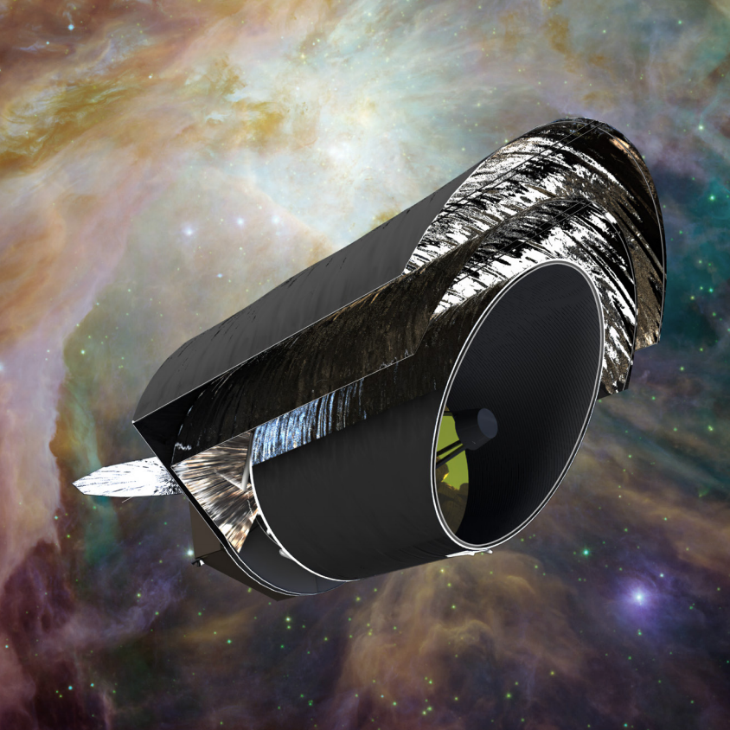
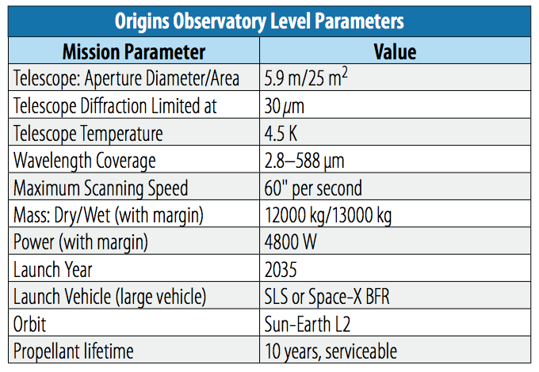
Origins Space Telescope
Mid-/Far-Infrared instruments (5-660 𝛍m)
✕ ~1000 better sensitivity than Herschel
  cold (4.5 K) telescope
Powerful imaging & spectroscopic instruments

Slide 34
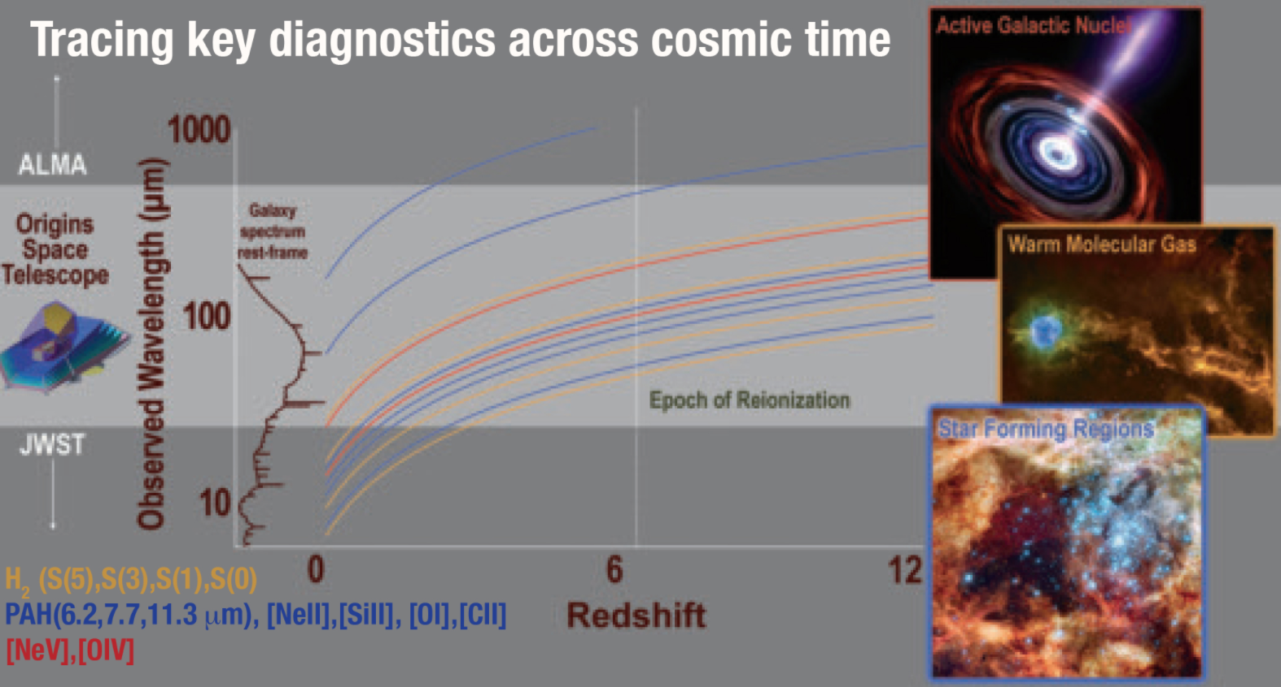
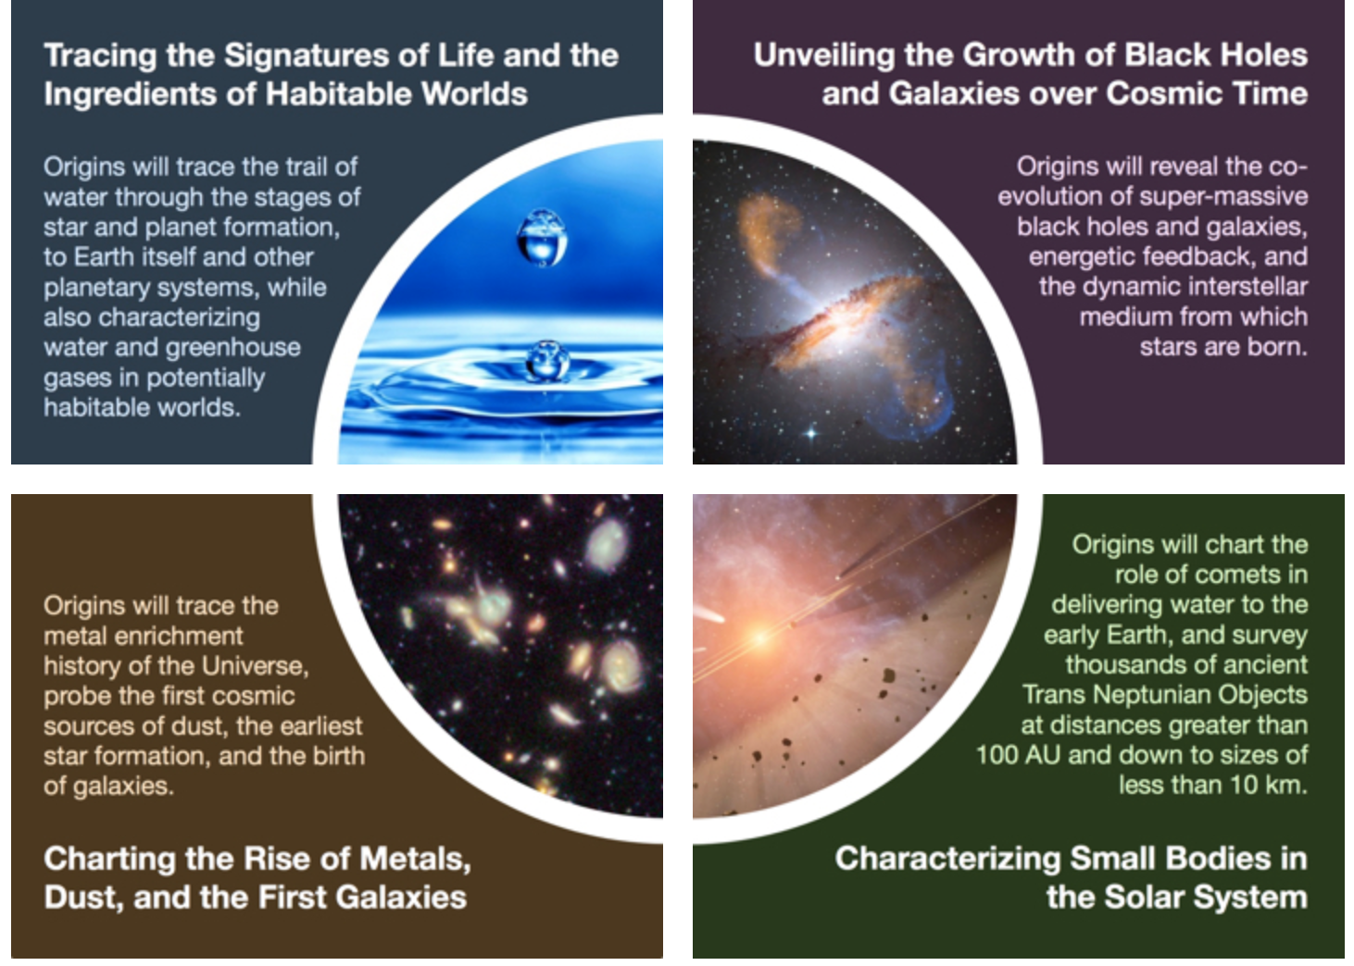
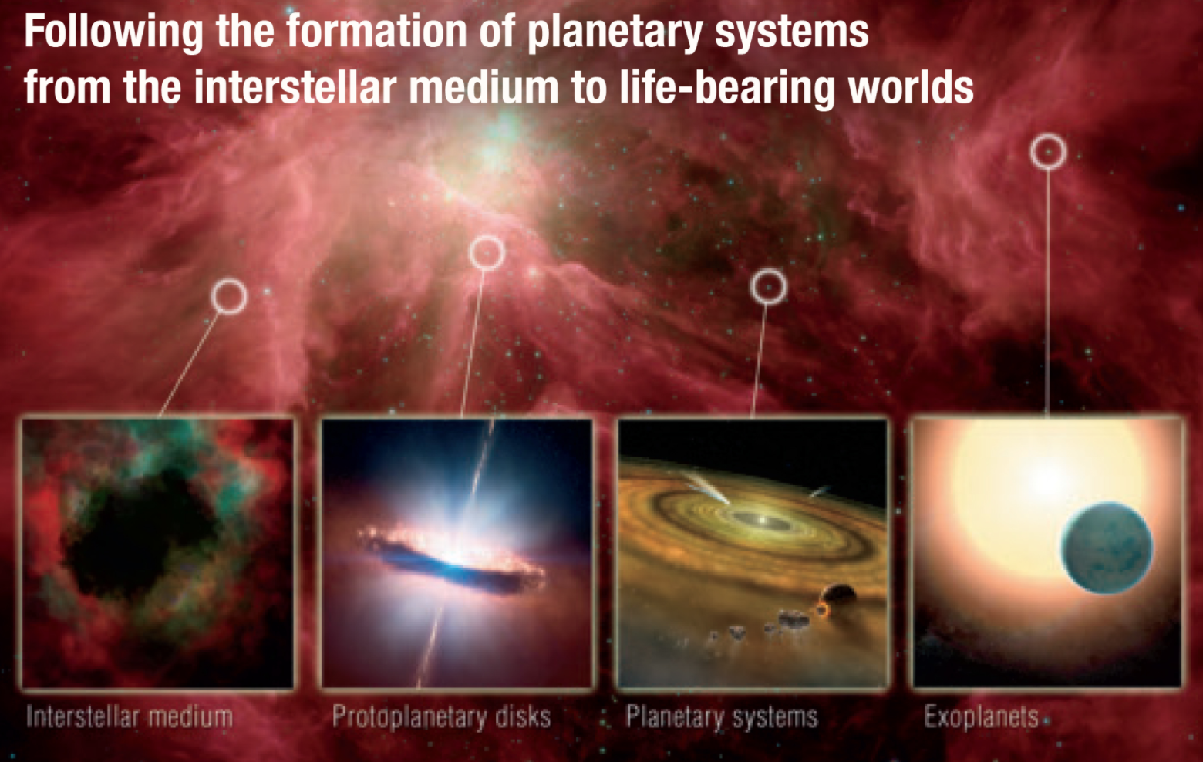
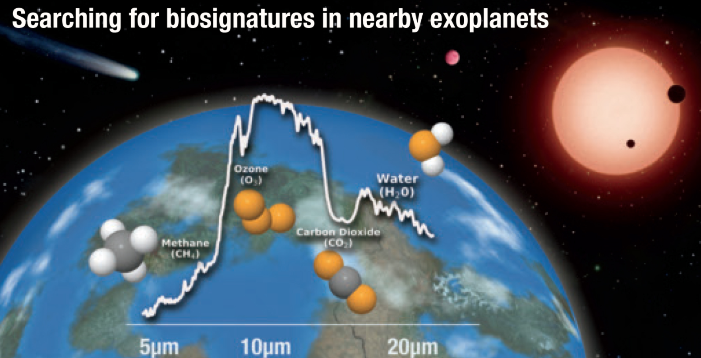
Origins - Key Science
THE DAWN OF BLACK HOLES

Slide 35
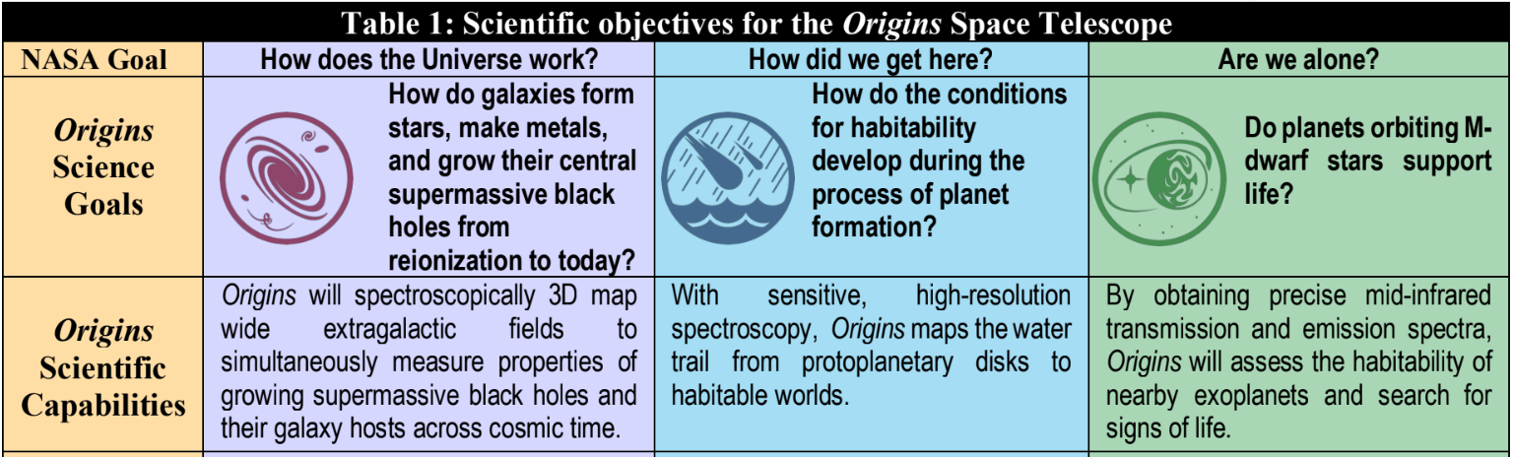
Origins - Key Science

Slide 36
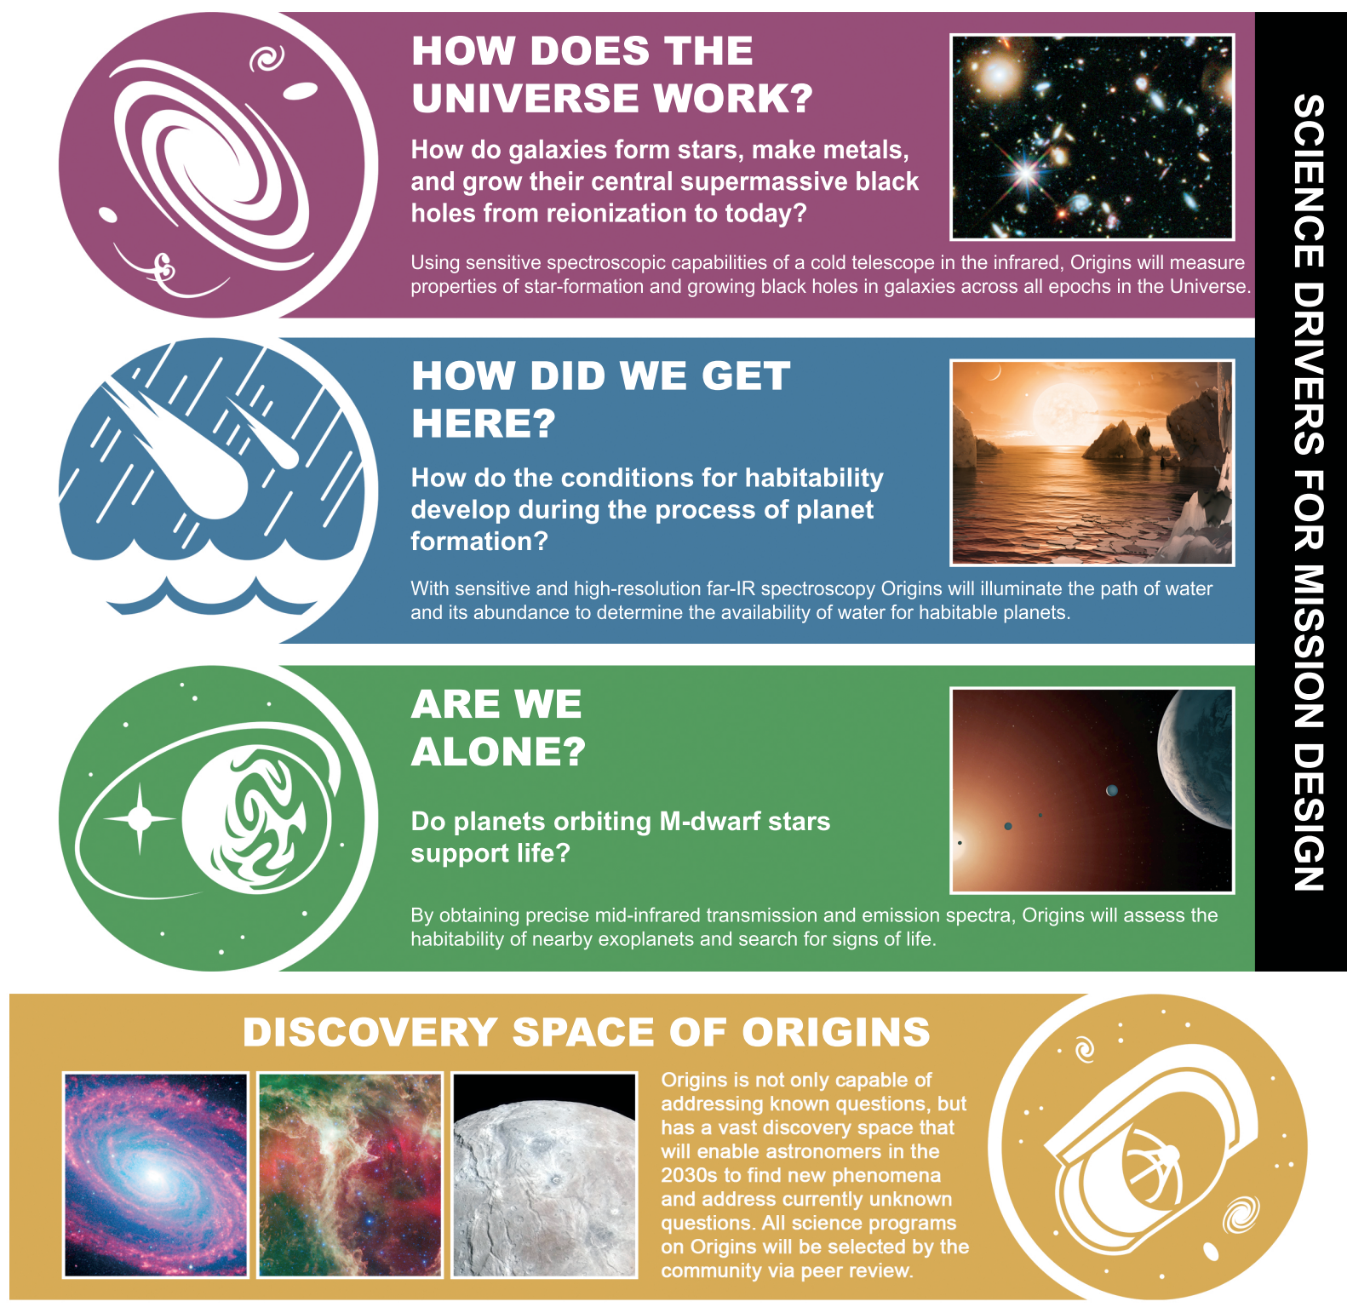
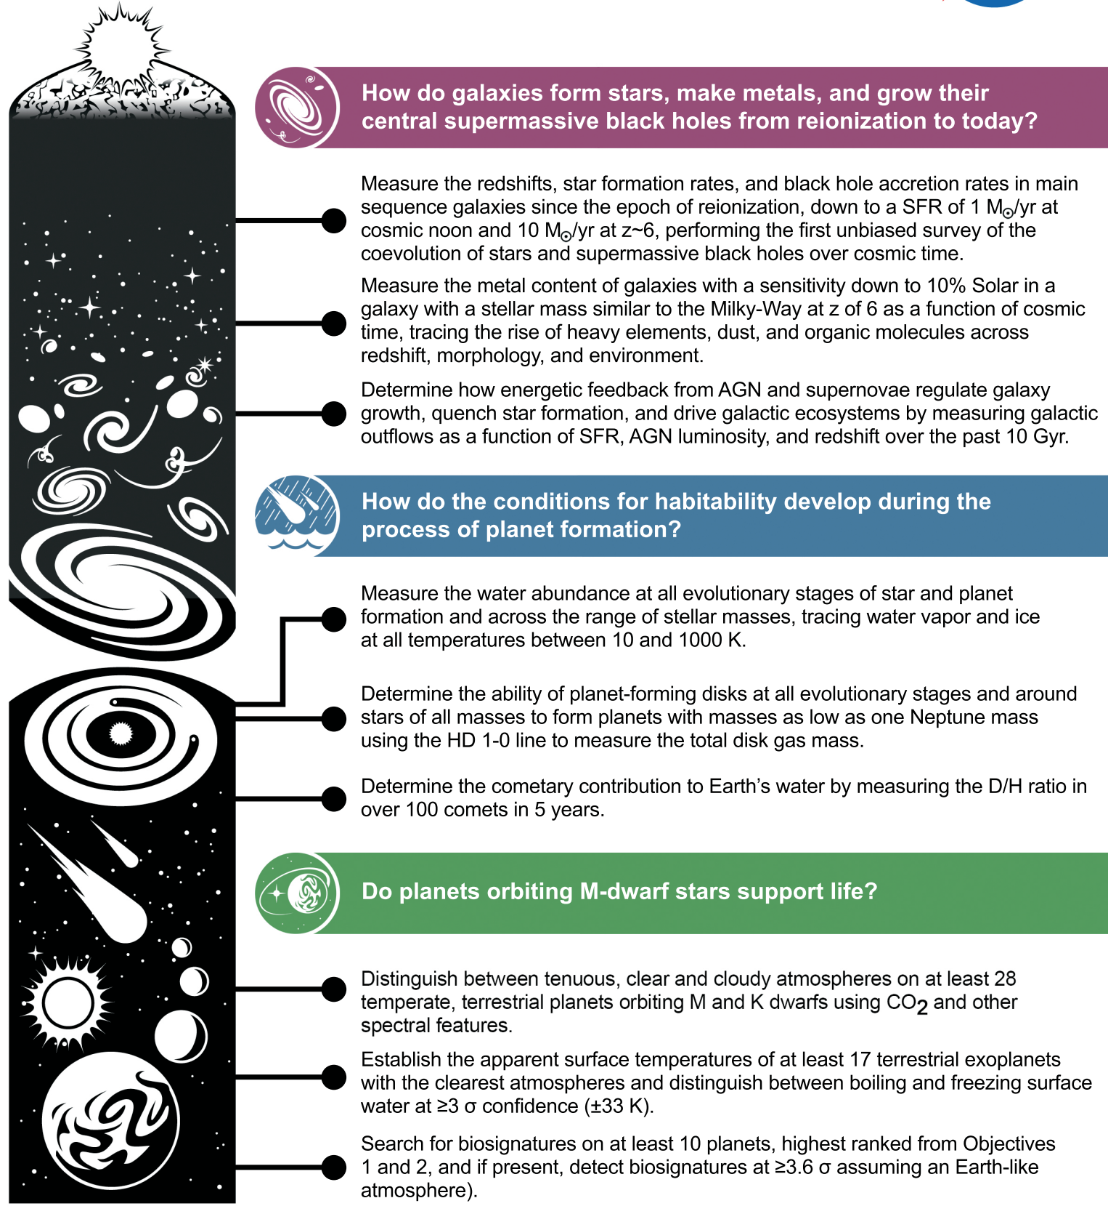
Origins - Key Science
THE DAWN OF BLACK HOLES
From Concept Study Report

Slide 37
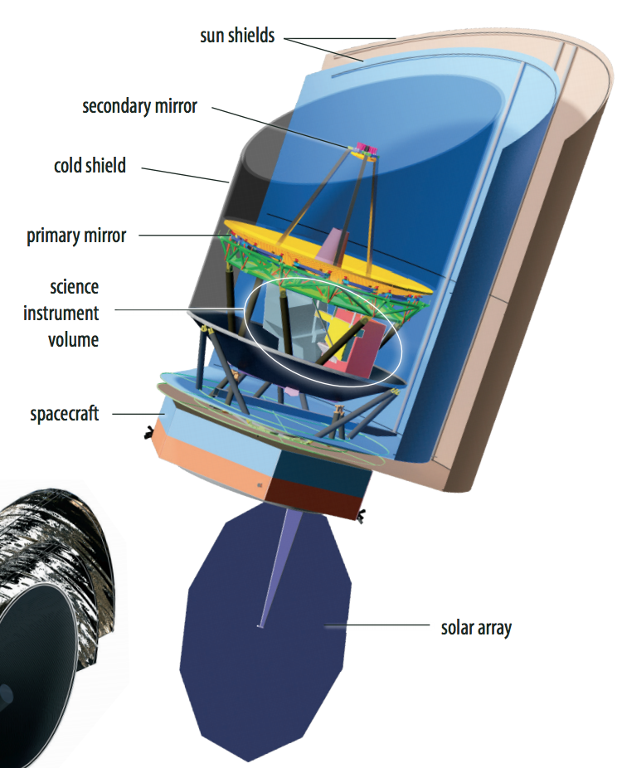
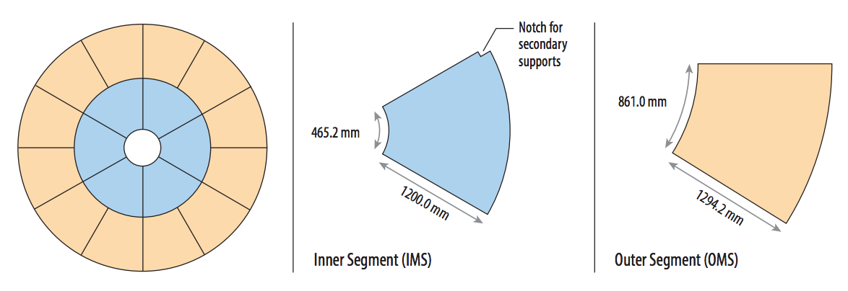
Origins - Payload
THE DAWN OF BLACK HOLES
5.9m

Slide 38
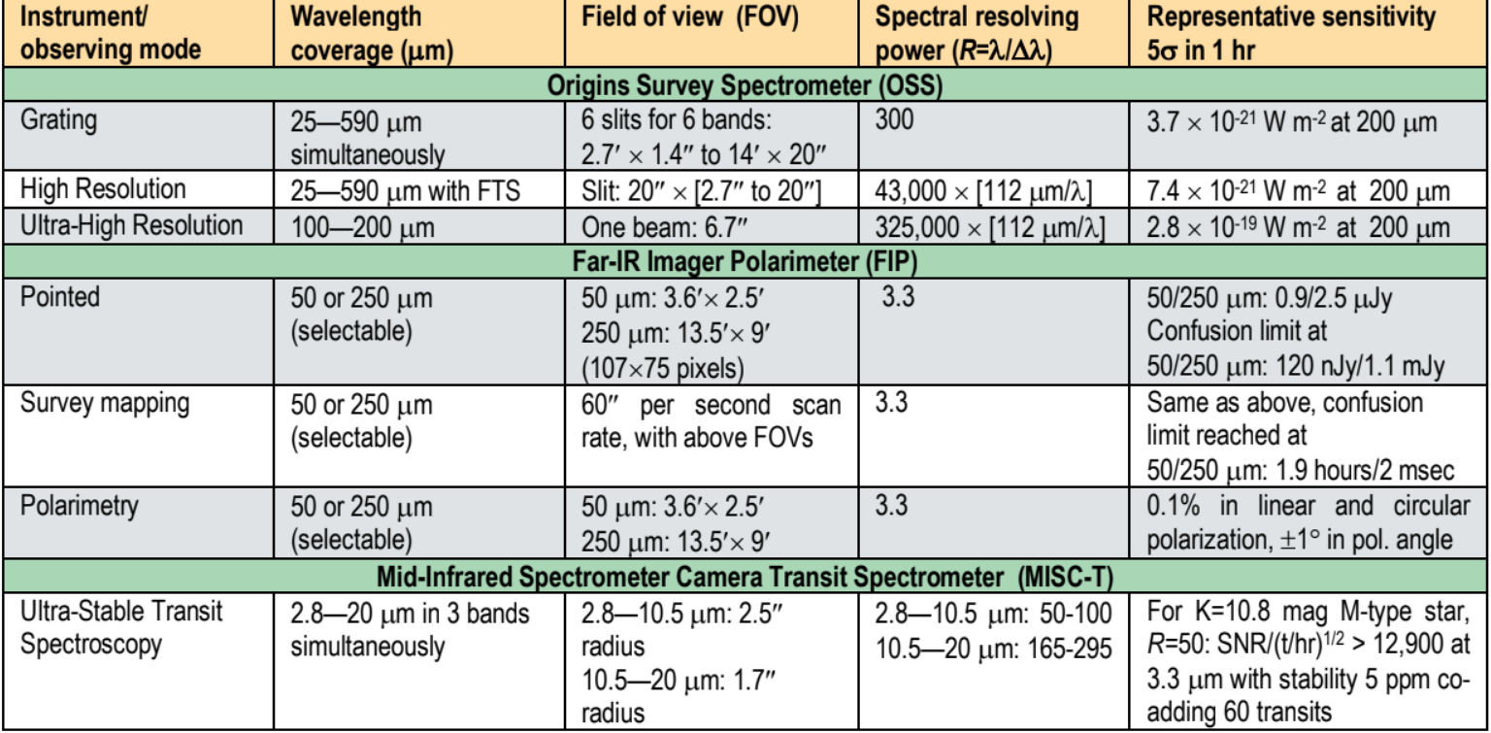
Origins - Instruments
THE DAWN OF BLACK HOLES
Notes:
MISC-T : Pupil densification to mitigate observatory jitter
Upscope options

Slide 39
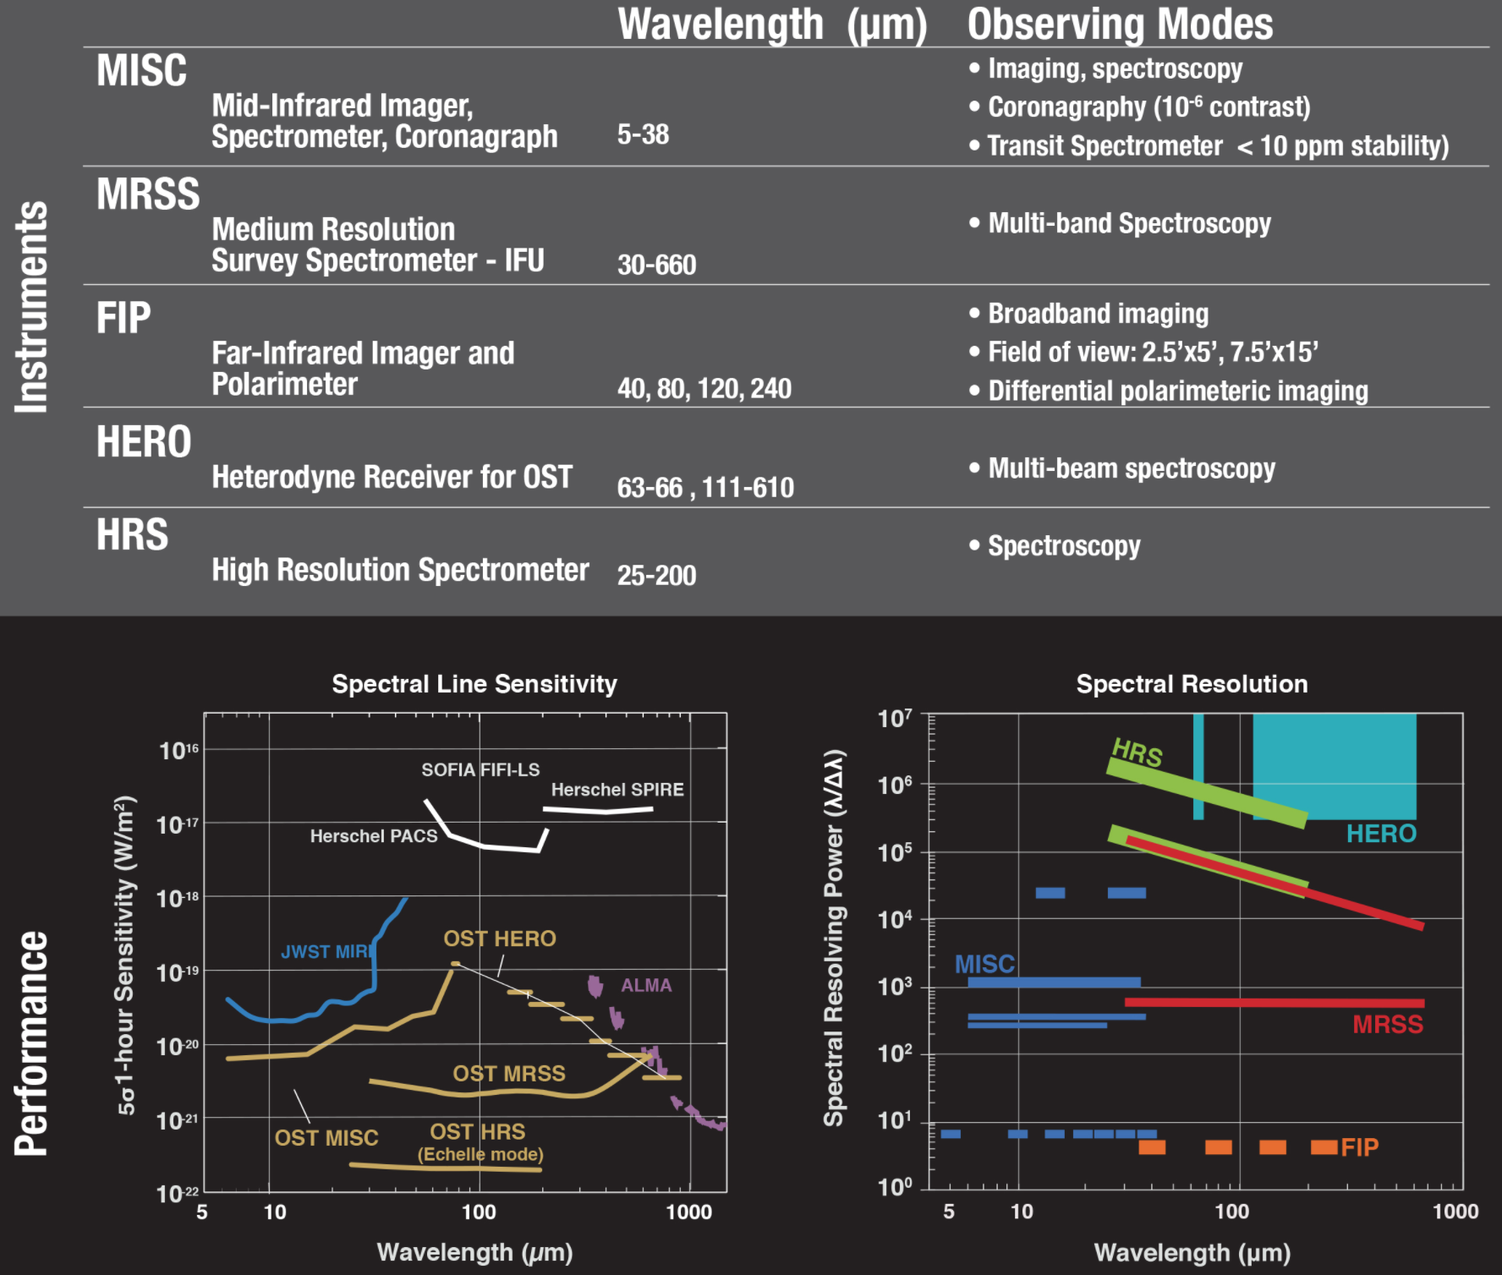
Origins - Instruments
Upscope options?
THE DAWN OF BLACK HOLES

Slide 40
10 Probe Missions
Name | Brief Description (could be incorrect)
AXIS | Chandra-like w/ larger FOV
CDIM | Better SPHEREx
CETUS | UV MOS Spectroscopy + alpha
Earthfinder | PRV from space
GEP | FIR SED mapper + spectrograph (long slit)
PICO | WMAP-like w/ 21 imaging polarimeter
POEMMA | Detecting air showers from space
Starshade | Starshade for WFIRST
STROBE-X | X-ray Timing
TAP | Better SWIFT
Name | Brief Description (could be incorrect)
AXIS | Chandra-like w/ larger FOV
CDIM | Better SPHEREx
CETUS | UV MOS Spectroscopy + alpha
Earthfinder | PRV from space
GEP | FIR SED mapper + spectrograph (long slit)
PICO | WMAP-like w/ 21 imaging polarimeter
POEMMA | Detecting air showers from space
Starshade | Starshade for WFIRST
STROBE-X | X-ray Timing
TAP | Better SWIFT

Slide 41
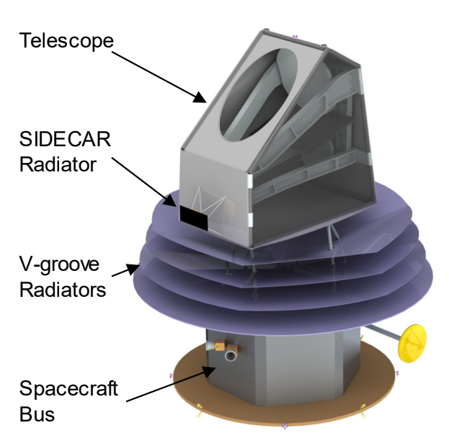
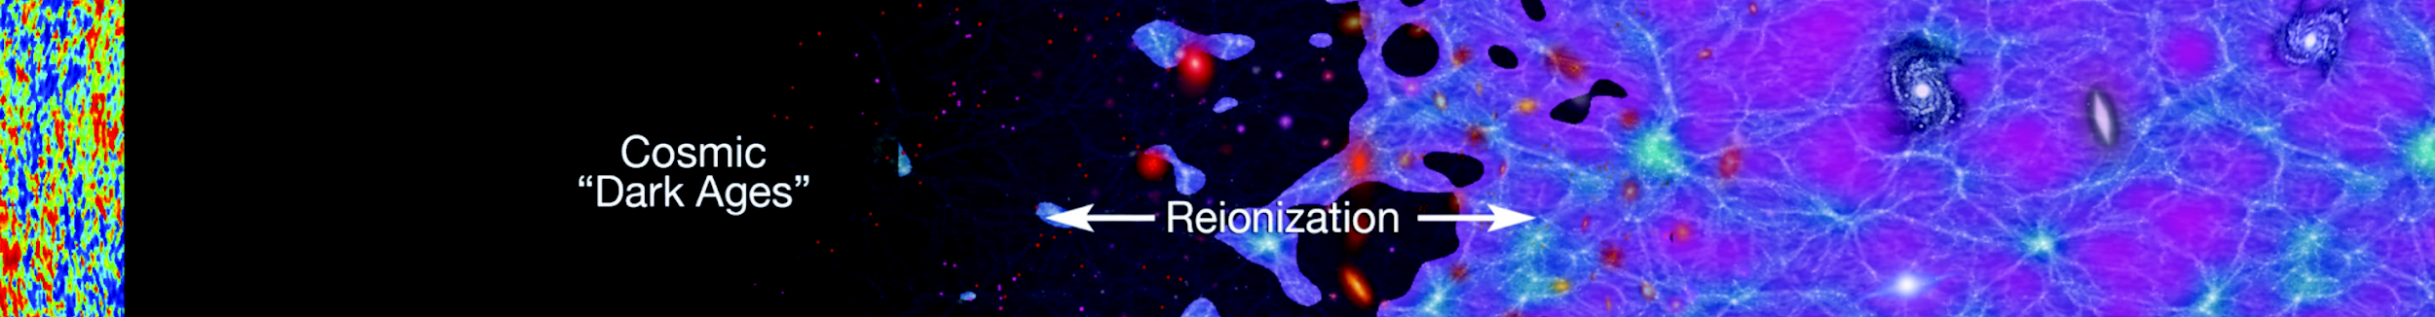
CDIM - Cosmic Dawn Intensity Mapper
CDIM will probe the era of reionization building upon the heritage of SPHEREx.
Near-IR Wide-field Spectro-Imaging Survey Telescope
Three-mirror all-reflective design with 0.83m clear aperture
LVF over 0.75 - 7.5 μm in 840 bands at R = 300
V-groove radiators. Passive cooling at T < 35K in L2 orbit. No moving parts.
4⨉6 H2RG detectors, FoV = 7.8 deg², 2′′ PSF (1′′ pixels)
4-year survey for key science (deep/medium/wide = 15/30/300 deg²)
+ extended mission for Guest Observer programs
Estimated cost = 1B USD (incl. 30% margin)

Slide 42
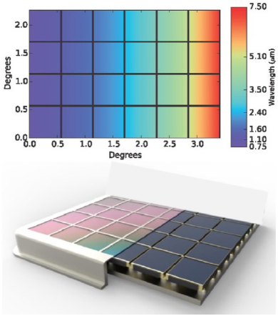
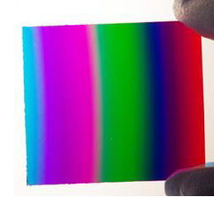
CDIM - Payload / Technology
H2RG Detectors
with 7.5 µm cutoff (TRL4)
X-ray telescope
Linear Variable Filter (LVF)
(TRL4)
CDIM Focal Plane & Filter
Extending the cutoff wavelength of Teledyne sensors further to infrared (7.5μm) to reach redshifted Hα emission at z=10
HgCdTe with cutoffs of 1.7, 2.5, 5.3μm (5 out of 6) are already available as standard products
Extending the current spectral range (~5μm) to 7.5μm & OD-5 out-of-band rejection
Filter size
= 40⨉40mm
4x6 2k H2RGs
TRL: Technology Readiness Level; TRL = 1 (basic) - 9 (flight proven)

Slide 43
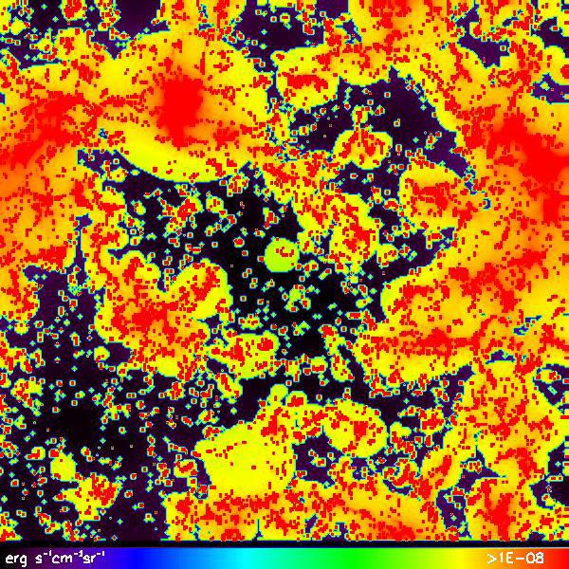
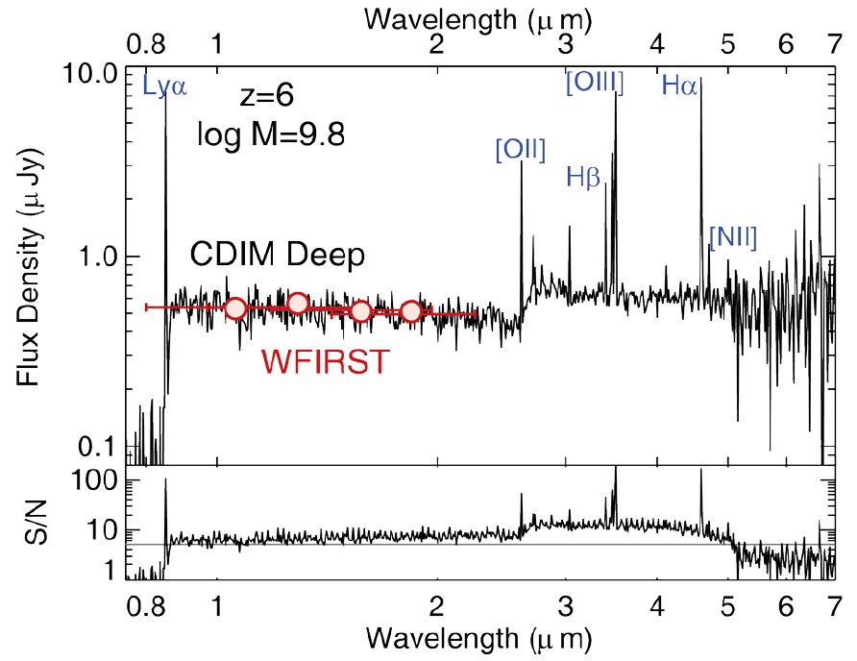
CDIM - Key Science
Measuring Physical Properties of Galaxies to z ~ 10
Finding Black Holes to z ~ 8
Mapping Reionization Topology & History for z = 5 - 10
Unbiased AGN sample: unlike traditional selection based on optical colors, CDIM low-res spectroscopy will directly find QSOs using strong emission lines (Lyα, Mg II, C IV).
Lyα, Hα, [OIII], Hβ, [NII] with
R = 300 spectra
Scattered Lyα from IGM@ z=7
Bomee Lee (KASI SPHEREx Team) is participating in the science team.

Slide 44
Cosmic Evolution Through UV Spectroscopy (CETUS)

Slide 45
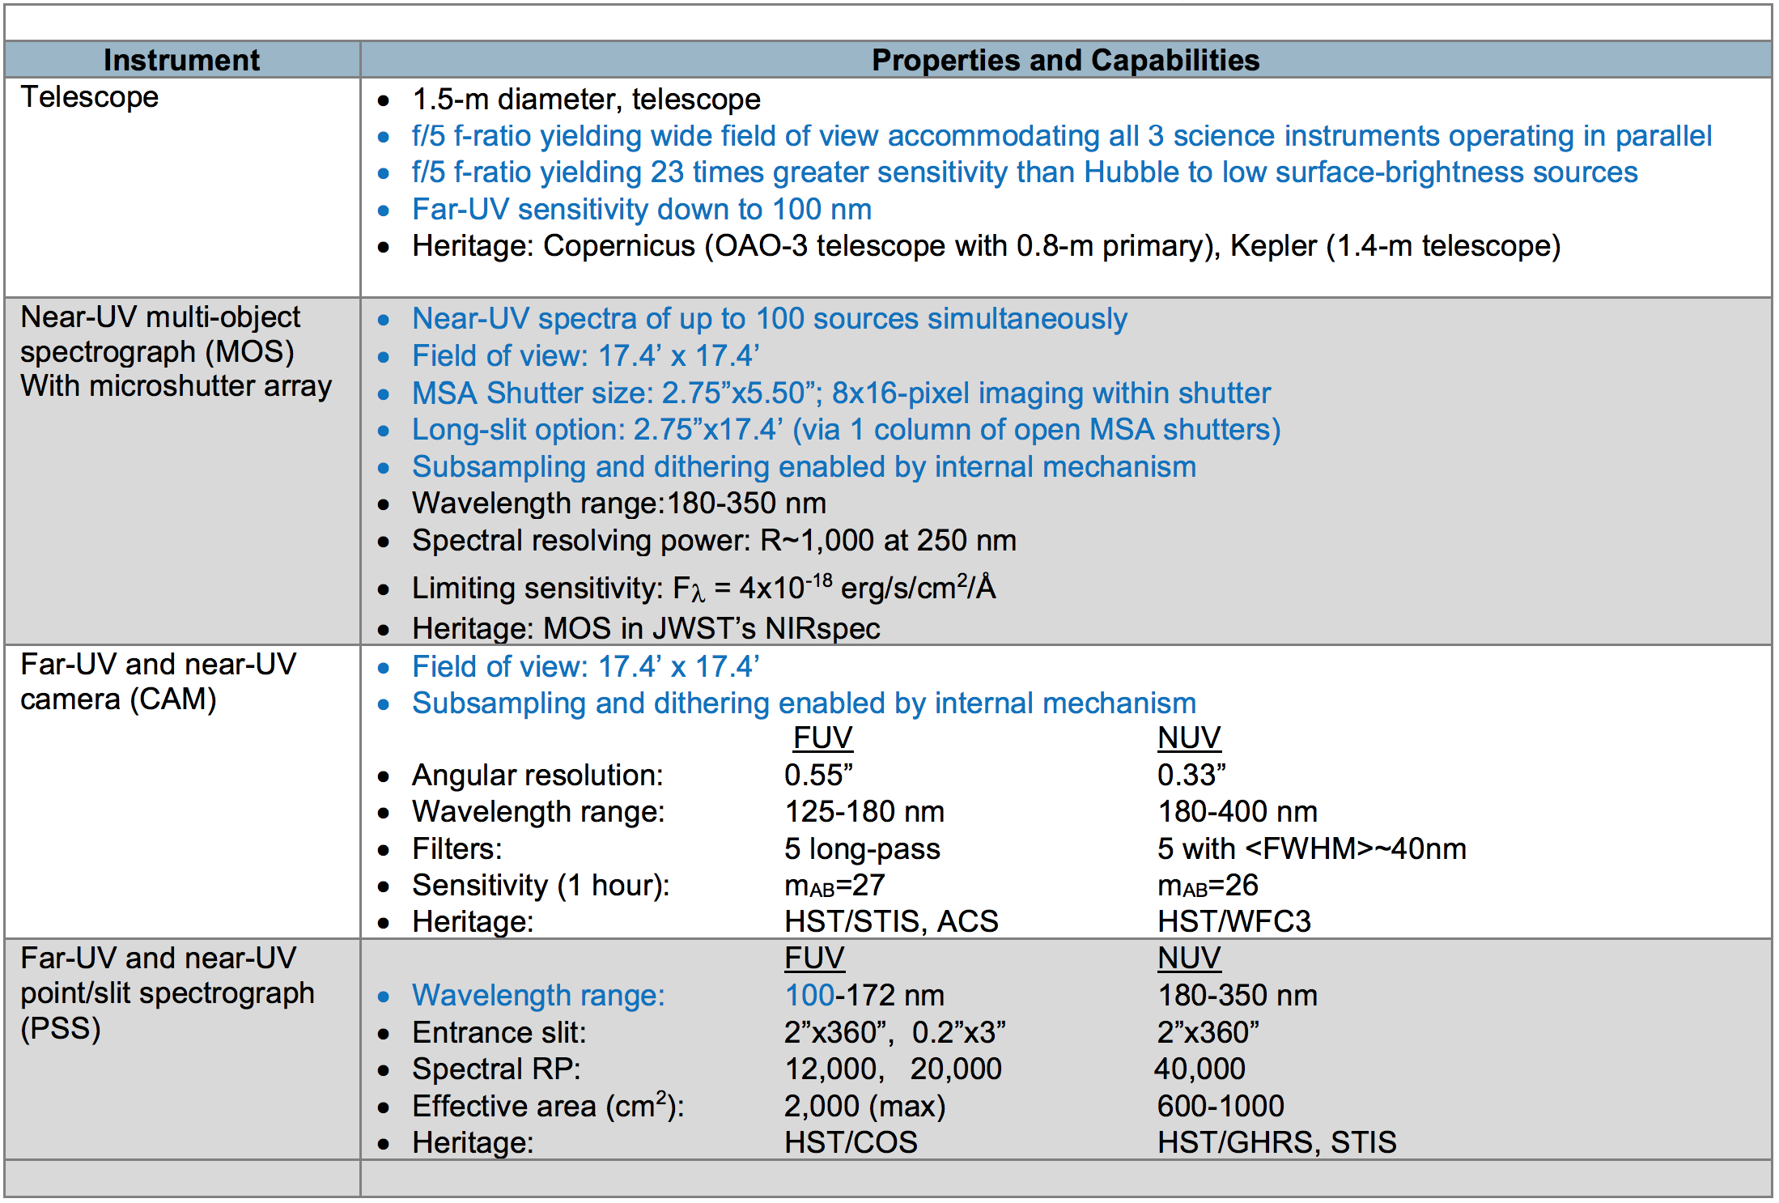
CETUS
Mission Plan
Launch Date
October 2030
Orbit
Sun-Earth L2
Duration
5 years

Slide 46
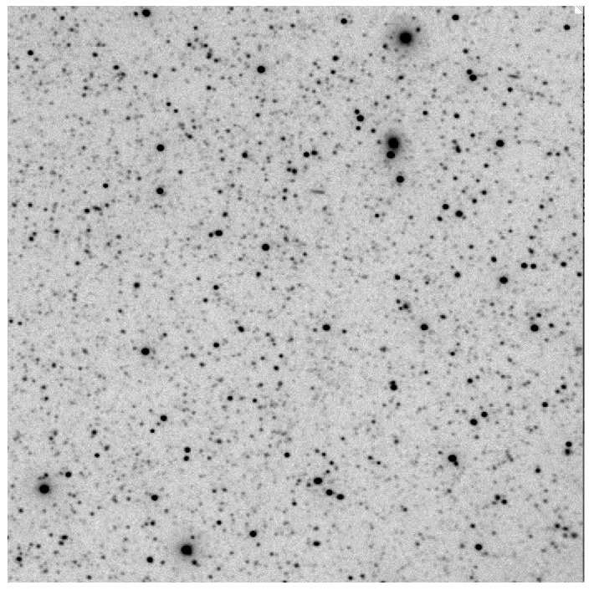
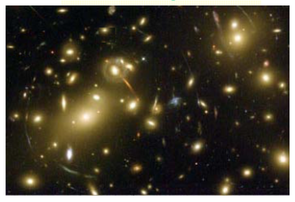
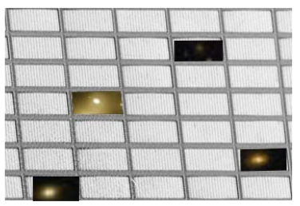
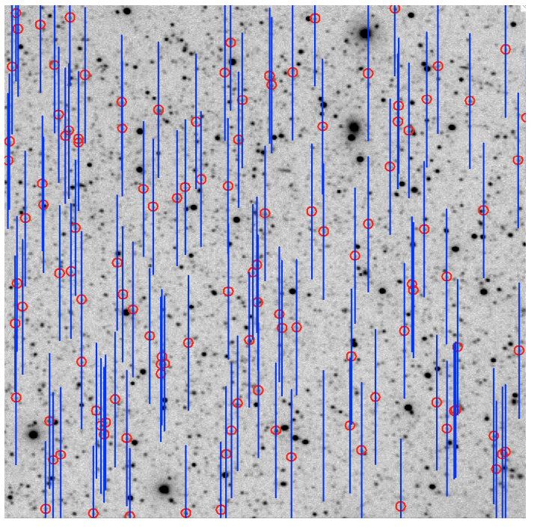
CETUS
Science Cases
Galaxy at low and high redshift
Dust in galaxies
Galactic and AGN wind
Emission line halos around galaxies
Transient
Neutron star binary merger (gravitational wave)
Tidal disruption event
Progenitor of core-collapse supernovae
Survey
>10⁵ UV spectra
Synergy with other surveys
Microshutter Array for MOS
Upgraded version of JWST NIRSpec
JWST example (Sohl+07)
https://ntrs.nasa.gov/citations/20170011235

Slide 47
EarthFinder Probe
Notes:
Science Goals
Probe Spec + Instruments
Ability & Expected Outputs
Expected Costs
Mission Overview
EarthFinder : A Diffraction-limited Precise Radial Velocity Observatory in Space (Partial Selection); Characterizing Nearby Stellar Exoplanet Systems With Earth-mass Analogs For Future Direct Imaging
The primary goal of the NASA EarthFinder Probe study was to investigate the necessity of a space mission to achieve the PRV precision required to detect Earth analogs orbiting the nearest bright stars which would also be the targets for future direct imaging missions.

Slide 48
New Paradigm Proposed for Developing EarthFinder Probe
[1] Broad wavelength coverage from the UV to NIR which is only possible from space to minimize the effects of stellar activity
[3] The revolution in laser based wavelength standards to ensure cm/s precision over many years
[5] Exploiting the absolute flux stability from space for continuum normalization for unprecedented line-by-line analysis not possible from the ground
[2] Extremely compact, highly stable, highly efficient spectrometers (R>150,000) which require the diffraction-limited imaging possible only from space over a broad wavelength range
[4] A high cadence observing program which minimizes sampling induced period aliases
[6] Focusing on the bright stars which will be the targets of future imaging missions so that EarthFinder can use a ~1.5 m telescope
Notes:
The primary science goals of EarthFinder are the precise radial velocity (PRV) detection, precise mass measurement, and orbit characterization of Earth-mass planets in
Habitable Zone orbits around the nearest FGKM stars.
Orbit:
Earth-trailing (similar to Kepler and Spitzer) or Earth-Sun Lagrange-point orbit.
EarthFinder will be placed in an Earth-Sun L2 libration point orbit, or perhaps a heliocentric drift away orbit
Spacecraft:
The payload, including the telescope, is mounted to
the spacecraft bus on an athermal interface
using a bipod arrangement. A cylindrical baffle
surrounds the telescope. EarthFinder has
thermal shields affixed to the S/C on the Sunoriented-
side of the telescope baffle, along with
solar arrays (also fixed to the S/C) installed
outward from the thermal shields. The arrays
work together with the thermal shields to isolate
the payload from solar insolation and reduce the
variability of the heat load due to changes in the
S/C pointing. There is a deployable high gain
antenna articulated to point towards the Earth.
Instrument:
single-mode fibers illuminating three high-resolution, compact and diffractionlimited spectrometer “arms”, one covering the near-UV (280-380 nm), visible (VIS; 380-950 nm) and near-infrared (NIR; 950-2500 nm) respectively with a spectral resolution of greater than 150,000 in the visible and near-infrared arms.
The observatory is optimized for the bright (V~5-6 mag) nearby main sequence stars.

Slide 49

EarthFinder Probe Overview
The precise radial velocity (PRV) detection to 1-10 cm/s level, precise mass measurement, and orbit characterization of Earth-mass planets in Habitable Zone orbits around the nearest FGKM stars
Spacecraft Heritage Concepts
Primary Goal
Notes:
The primary science goals of EarthFinder are the precise radial velocity (PRV) detection, precise mass measurement, and orbit characterization of Earth-mass planets in
Habitable Zone orbits around the nearest FGKM stars.
Orbit:
Earth-trailing (similar to Kepler and Spitzer) or Earth-Sun Lagrange-point orbit.
EarthFinder will be placed in an Earth-Sun L2 libration point orbit, or perhaps a heliocentric drift away orbit
Spacecraft:
The payload, including the telescope, is mounted to
the spacecraft bus on an athermal interface
using a bipod arrangement. A cylindrical baffle
surrounds the telescope. EarthFinder has
thermal shields affixed to the S/C on the Sunoriented-
side of the telescope baffle, along with
solar arrays (also fixed to the S/C) installed
outward from the thermal shields. The arrays
work together with the thermal shields to isolate
the payload from solar insolation and reduce the
variability of the heat load due to changes in the
S/C pointing. There is a deployable high gain
antenna articulated to point towards the Earth.
Instrument:
single-mode fibers illuminating three high-resolution, compact and diffractionlimited spectrometer “arms”, one covering the near-UV (280-380 nm), visible (VIS; 380-950 nm) and near-infrared (NIR; 950-2500 nm) respectively with a spectral resolution of greater than 150,000 in the visible and near-infrared arms.
The observatory is optimized for the bright (V~5-6 mag) nearby main sequence stars.

Slide 50

EarthFinder Payload Details (Telescope + Instruments)
Telescope
Instrument
1.45m Primary Mirror (M1)
The precise radial velocity (PRV) detection to 1-10 cm/s level
  precise mass measurement, and orbit characterization of Earth-mass planets in Habitable Zone orbits around the nearest FGKM stars
Notes:
Telescope:
The EarthFinder telescope uses a 1.45 m
diameter primary mirror (M1) with an f/# of
1.85, and a total length of 2 m. The secondary
mirror (M2) has 0.36 m diameter, resulting in an
obscuration ratio of 0.25.
1.45 m telescope in a Ritchey-Chretien
Configuration
The total mass of the payload is 230 kg
at current best estimate with 30% contingency

Slide 51
EarthFinder Instrument Details
Fine Guidance System
UV Spectrometer
Optical & NIR Sp
Consists of
Fast Guidance Camera (FGC)
Fast Steering Mirror (FSM)
Pointing Control Algorithms
280-380 nm
Band1 mode (default) : the entire span at a medium resolving power of R=3000 with 2-pixel sampling per spectral channel
Band2 mode
: covers 278-281 nm, providing a 10x higher resolving power of 30,000
The OPS and NIRS share a common design based on a cross-dispersed white light Echelle to achieve high spectral resolution, R~170,000Å×(λ0/λ) where λ0=0.6 μm or λ=1.6 μm.
Notes:
Fine Guidance System
the Fast Guidance Camera (FGC), the Fast Steering Mirror (FSM), the pointing control algorithms
UVS
Band 1 : the entire span at a
medium resolving power of R=3000 with 2-
pixel sampling per spectral channel and a plate
scale of 0.1 nm.
278-281 nm, and
provides a 10x higher resolving power of 30,000
(0.0093 nm per channel).

Slide 52

EarthFinder NIR Echelle Spectrometer Details
Light enters via a bundle of single mode fibers (short and long wavelengths, sky, optical fiber combs) and is collimated into a ~25 mm diameter beam and projected onto an R4 echelle grating (~10 lines/mm) using a Three Mirror Anastigmat (TMA).
The overall scale of the optics footprint is 0.4m×0.7 m.
Schematic based on a two-arm design
for Keck HIPEC instrument
Notes:
Figure 2-4 gives a schematic of the NIR spectrometer based on a two-arm design for the Keck HISPEC instrument, wherein both short and long wavelength arms use a common Echelle grating but separate fibers.

Slide 53

EarthFinder Cost Assessment
The cost estimate of $755M ($905M including launch vehicle in FY18 dollars).
The estimate includes 30% of unreserved costs as cost reserves as required by JPL best practices.
Notes:
The primary science goals of EarthFinder are the precise radial velocity (PRV) detection, precise mass measurement, and orbit characterization of Earth-mass planets in
Habitable Zone orbits around the nearest FGKM stars.
Orbit:
Earth-trailing (similar to Kepler and Spitzer) or Earth-Sun Lagrange-point orbit.
EarthFinder will be placed in an Earth-Sun L2 libration point orbit, or perhaps a heliocentric drift away orbit
Spacecraft:
The payload, including the telescope, is mounted to
the spacecraft bus on an athermal interface
using a bipod arrangement. A cylindrical baffle
surrounds the telescope. EarthFinder has
thermal shields affixed to the S/C on the Sunoriented-
side of the telescope baffle, along with
solar arrays (also fixed to the S/C) installed
outward from the thermal shields. The arrays
work together with the thermal shields to isolate
the payload from solar insolation and reduce the
variability of the heat load due to changes in the
S/C pointing. There is a deployable high gain
antenna articulated to point towards the Earth.
Instrument:
single-mode fibers illuminating three high-resolution, compact and diffractionlimited spectrometer “arms”, one covering the near-UV (280-380 nm), visible (VIS; 380-950 nm) and near-infrared (NIR; 950-2500 nm) respectively with a spectral resolution of greater than 150,000 in the visible and near-infrared arms.
The observatory is optimized for the bright (V~5-6 mag) nearby main sequence stars.

Slide 54
Galaxy Evolution Probe

Slide 55


GEP - Galaxy Evolution Probe

Slide 56

GEP - Galaxy Evolution Probe

Slide 57

GEP - Galaxy Evolution Probe

Slide 58

GEP - Galaxy Evolution Probe
KID : 10-400 μm
Si:As IBC (Impurity Band Conduction; MIRI on JWST) : < 28 μm
TES bolometers : smaller multiplexing density

Slide 59

GEP - Galaxy Evolution Probe

Slide 60
Keywords
Habitable world
  Coronagraph / Starshade
  Direct Imaging / Spectrograph
Survey Capability
  Large FOV
  Multibands
  MOS w/ Micro Shutter Array
Deployable
  segmented wavefront control
  Sunshade / Starshade
  c.f., launch fairing is also getting larger
Cold
  Sunshade
  Most of the missions will be at Sun-Earth L2 point.
High Contrast Coronagraph
  Active control of wavefront (Deformable Mirror)

Slide 61
감사합니다

Slide 62

The 2014 NASA Visionary Roadmap
“Enduring Quests, Daring Visions”

