Slide 1
Galaxy Cluster Mass with CNN
and comparison with a Rotation-Invariant CNN (RI-CNN)
Group L
Allen Neil Garcia, Hyojun Lee & Jui-Kuan Chan
August 22, 2025 @ A3Net, KIAS, Seoul

Slide 2
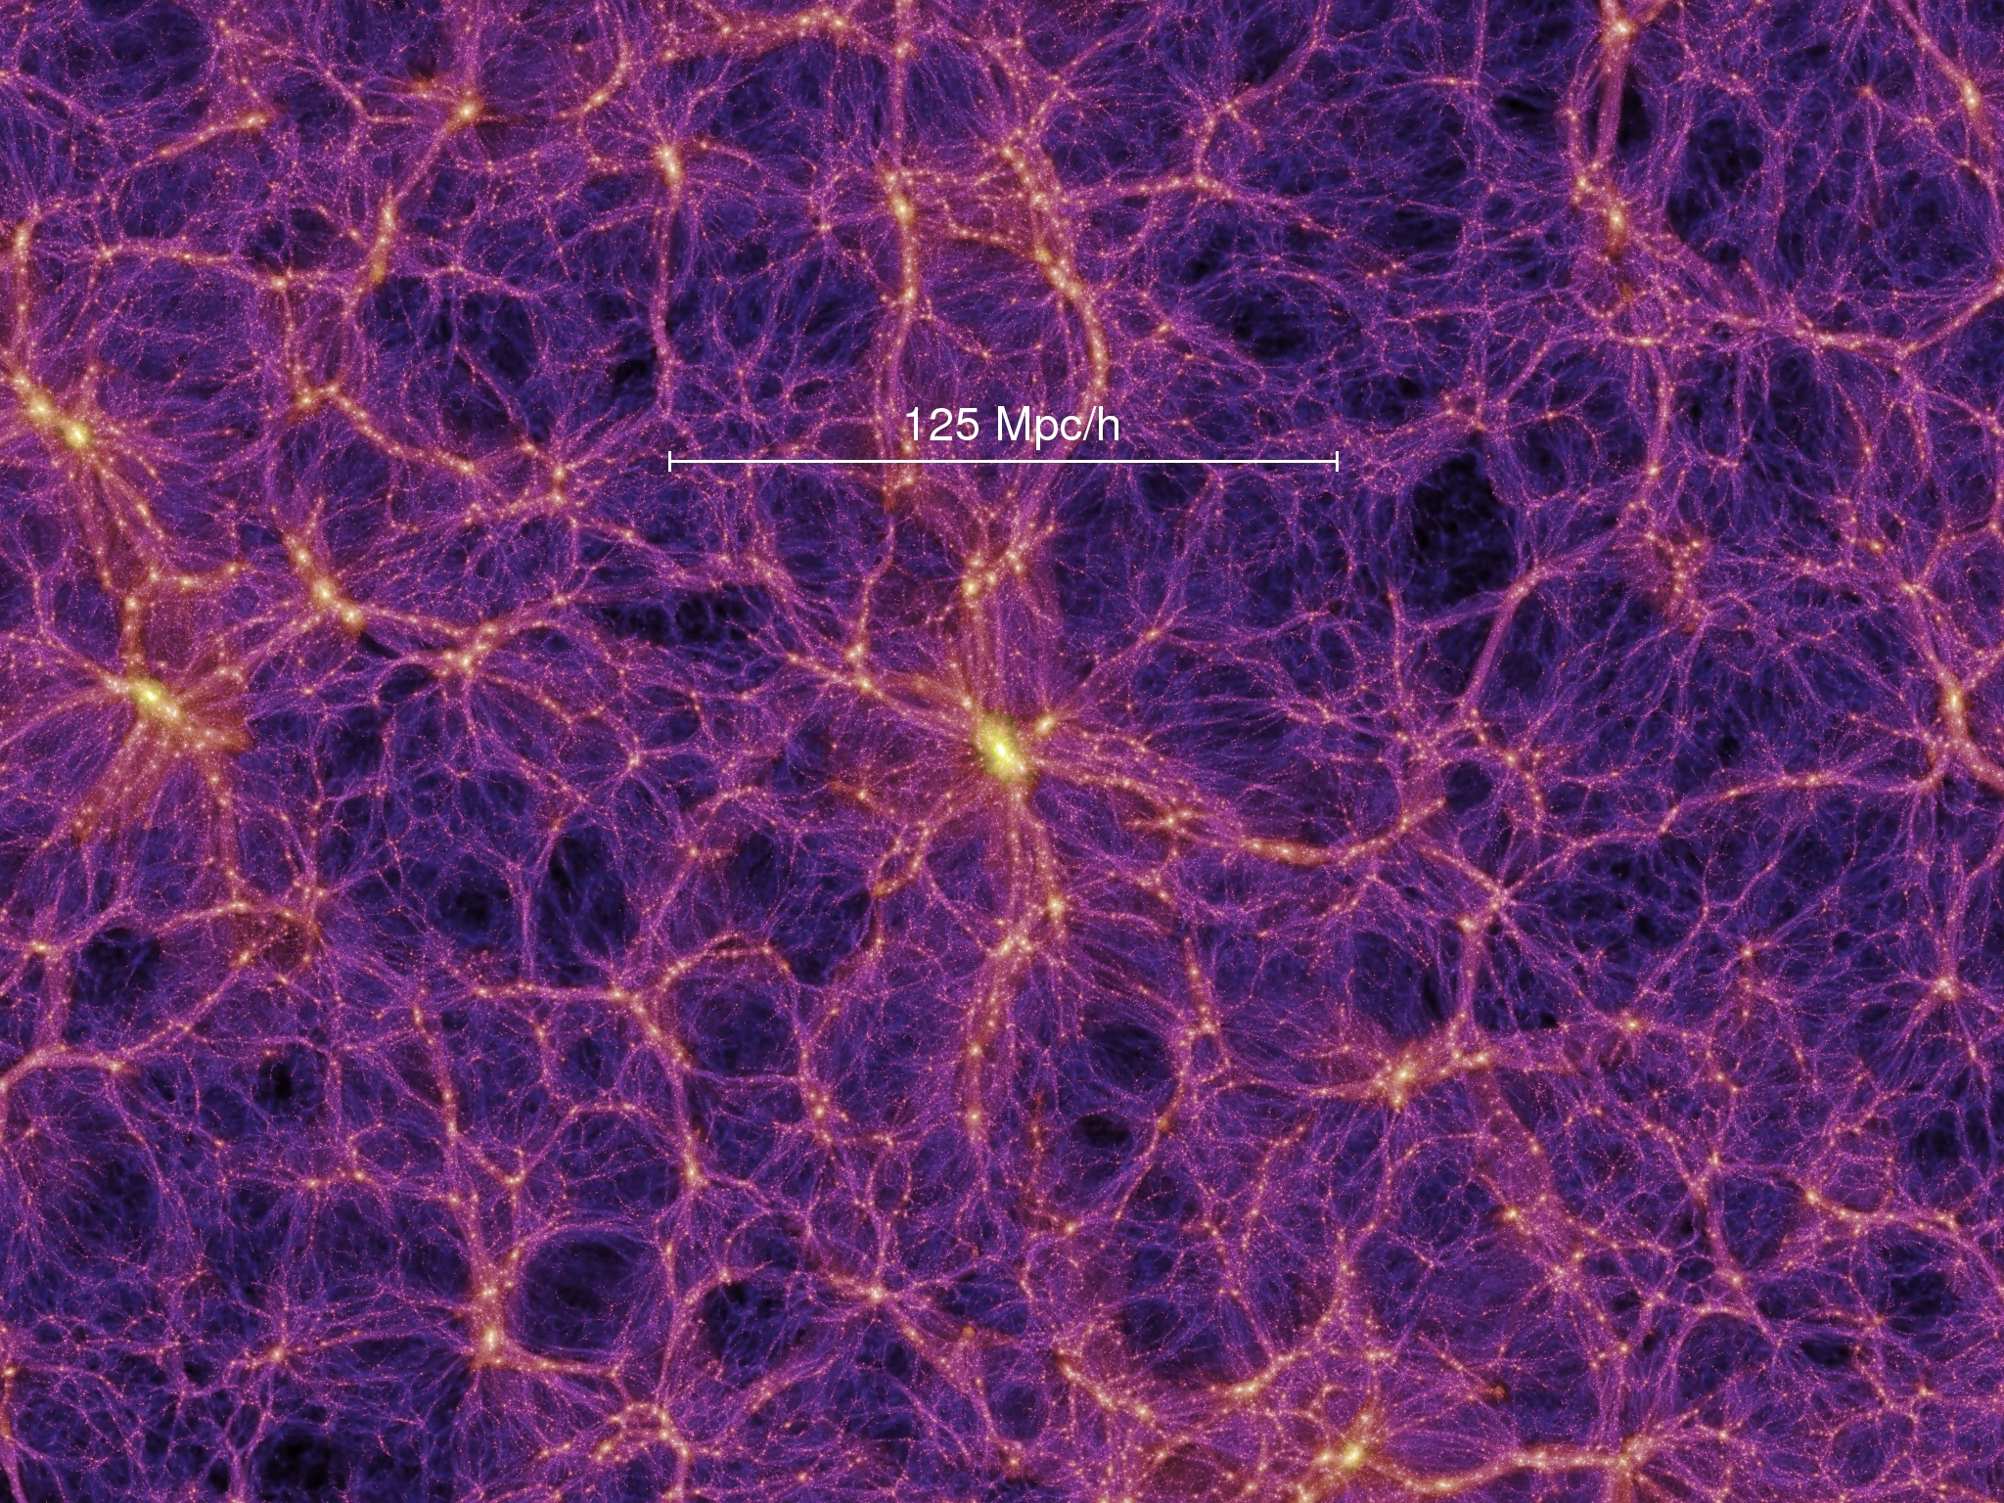
The Large-Scale Structure
Galaxy clusters: major probes in cosmology
Poor mass estimation → biased cosmology

Slide 3
A Deep Learning Approach to Galaxy Cluster X-ray Masses
Goal: Predict a galaxy cluster’s mass (M500c) directly from its X-ray image using a Convolutional Neural Network (CNN).
Key idea: Let the CNN learn complex patterns in the spatial photon counts; no spectroscopy needed.
Data: 7,896 mock Chandra observations from 329 clusters (IllustrisTNG-TNG300).
Setup: 100 ks exposure, 0.5–7 keV band, images downsampled to 128×128.
Augmentation: 3 projections × rotations/reflections → 24 images/cluster (handles “rotation”)

Slide 4
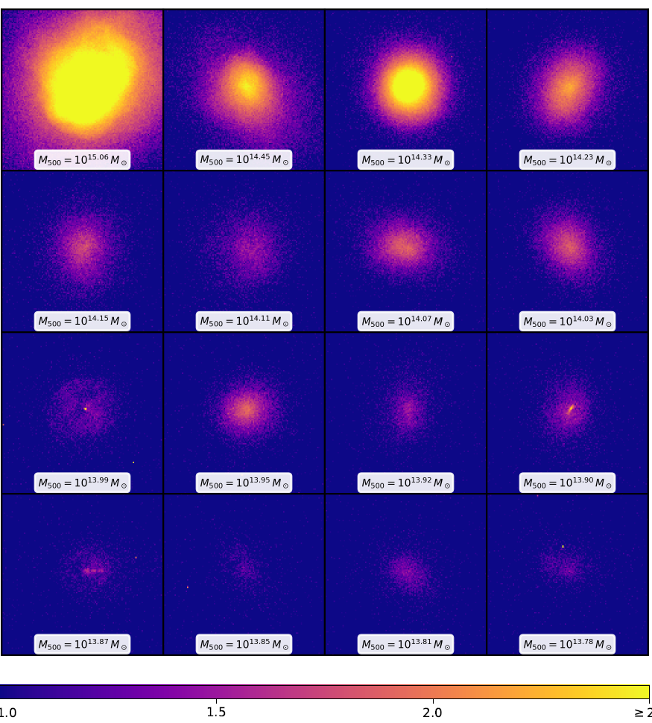
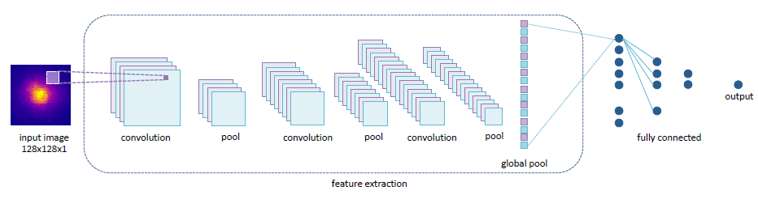
Preprocessing: Crop to 128×128, use photon counts only (no spectra). Target label: Cluster mass, log(M500c).
CNN architecture:
  3× Conv(3×3) with 16/32/64 filters, each followed by MaxPool(2×2, stride 2)
  Global Average Pooling → FC 200 → FC 100 → FC 20 → Output(1)
  Dropout 10% after the first two FC layers (~58k trainable params)
Training: MSE loss, Adam optimizer (lr 0.0005), 10-fold cross-validation with cluster-level separation (no leak across folds).
Early-stop checks (on validation): low max residual, low median bias, slope > 0.9; otherwise cap at 400 epochs.
Note for our hack: Baseline isn’t rotation-invariant → we’ll try a rotation-invariant CNN and compare.

Slide 5
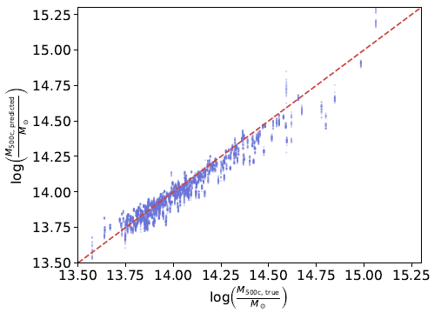
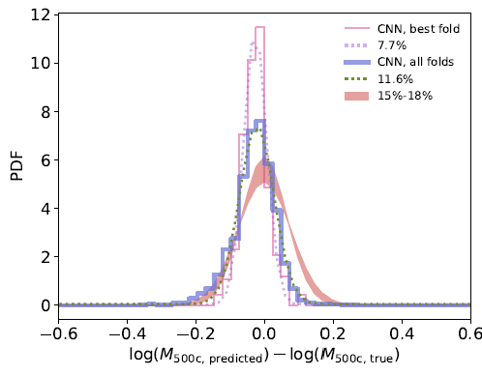
Accuracy: σ ≈ 0.051 dex (~11.6% scatter) over 10 folds; best fold ~7.7%.
Bias: Small, around –0.022 dex overall.
vs. classic methods: beats luminosity-based cluster mass measurement (~15-18% scatter vs ~8-12%)
Model insight: The CNN ignores cores and focuses on the outskirts; consistent with physical observation (cores are complex)
Conclusion: Low-res X-ray images are enough for low-bias, low-scatter mass estimates; larger sims & better sampling should reduce scatter further.

Slide 6
Project Goals
Use the paper’s dataset and methods to predict galaxy cluster mass from mock Chandra X-ray images with a CNN.
Reproduce the paper’s results end-to-end (same preprocessing, splits, and metrics).
Then test a rotationally invariant CNN and check if it improves accuracy.
Deliver a baseline + improved model comparison for the hack.

Slide 7
Reproduce the paper’s training pipeline:
Same inputs (128×128 images, 0.5–7 keV band), target log(M500c).
Same augmentation & cluster-level cross-validation (avoid leakage).
Record scatter (dex) and bias for a faithful baseline.
Extend with rotation-invariant modeling across architectures:
RI-CNN: rotationally invariant design (e.g., rotation-averaged predictions or equivariant layers).
Evaluate & compare:
Check accuracy (scatter), bias vs. the paper’s CNN baseline.
With vs. without rotation-invariant steps → see which model benefits most and where the paper’s method can be improved.

Slide 8
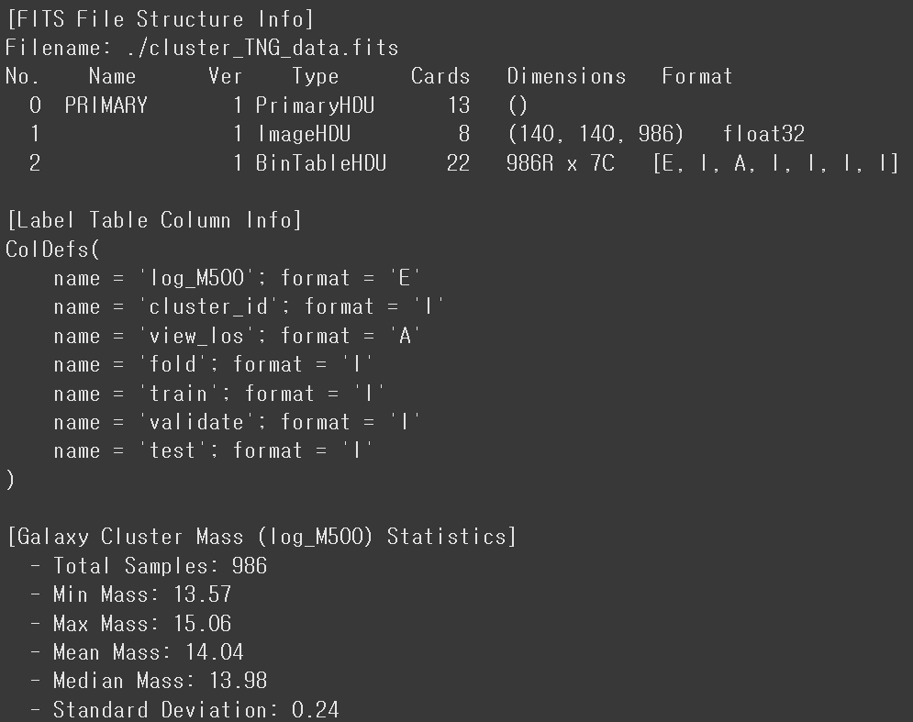
Cluster Data

Slide 9
Cluster Data

Slide 10
Cluster Data

Slide 11
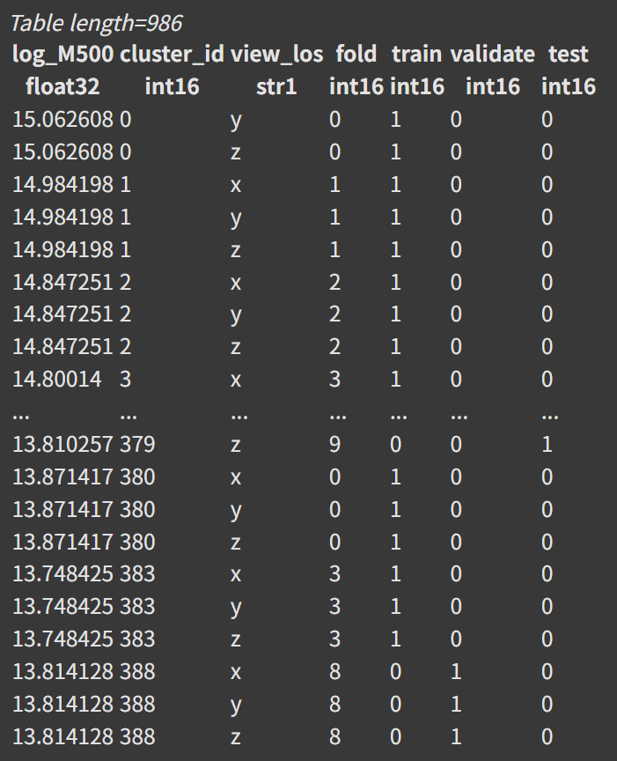
Cluster Data

Slide 12
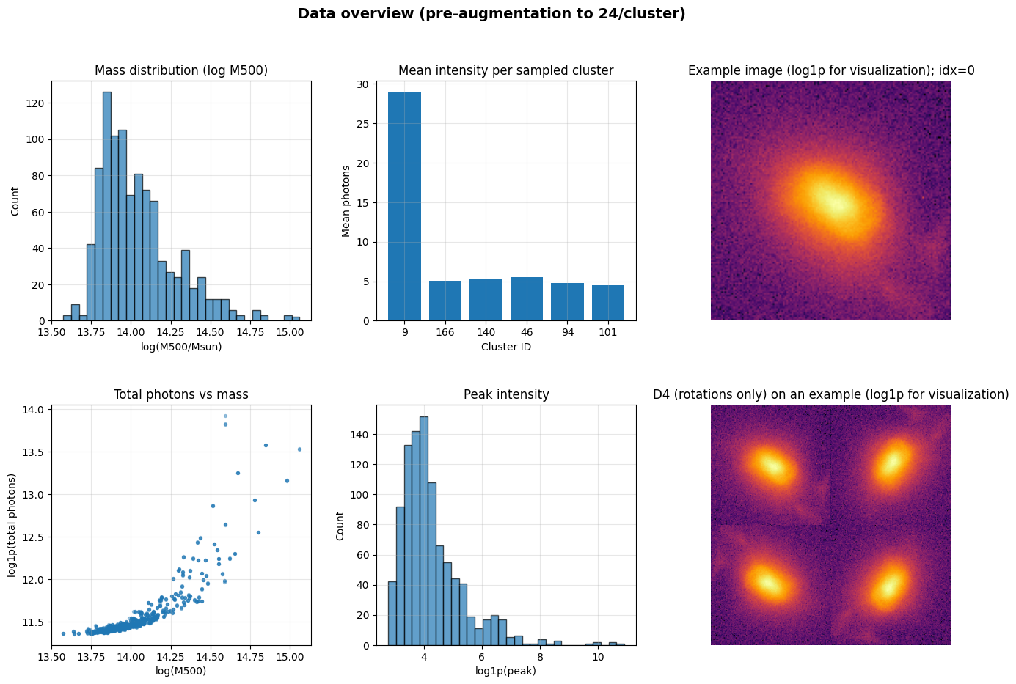
Data Augmentation (Paper)
Unique cluster: 329
Base image: 329 x 3 = 986
(clust_0 lack x view)

Slide 13
Data Augmentation (Paper)
Rotate 90° X n
Unique cluster: 329
View image: 329 x 3 = 986
(clust_0 lack x view)
Final data: 986 x 8 = 7,888 images

Slide 14
Data Augmentation (Paper)
Rotate 90° X n
Unique cluster: 329
View image: 329 x 3 = 986
(clust_0 lack x view)
Final data: 986 x 8 = 7,888 images
10-fold cross validation (cluster level) → augmentation (no leakage)

Slide 16
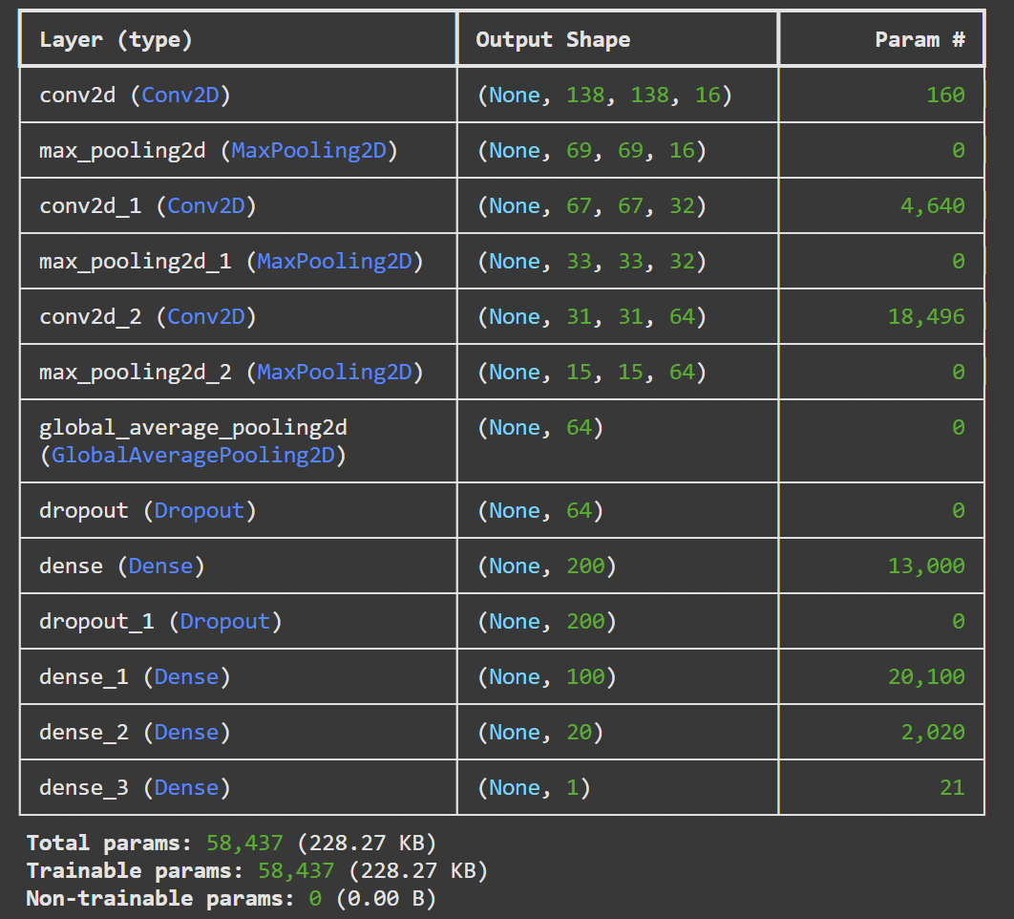
Baseline CNN — Paper’s Architecture
Convolution (3 layers)
→ feature extraction
→ Global Average Pooling

Slide 17
Baseline CNN — Paper’s Architecture
Convolution (3 layers)
→ feature extraction
→ Global Average Pooling
Fully-connected (4 layers)
→ mass prediction (single value)

Slide 18
Baseline CNN — Paper’s Architecture
Convolution (3 layers)
→ feature extraction
→ Global Average Pooling
Fully-connected (4 layers)
→ mass prediction (single value)
Total parameters: 58,437

Slide 19
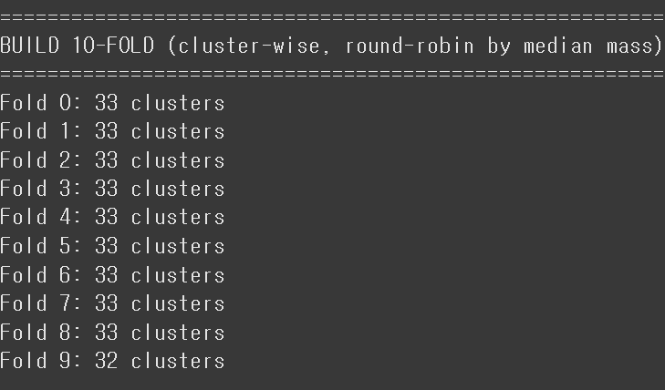
Baseline CNN — Paper’s Architecture

Slide 20
Baseline CNN
Reproduce the paper’s model architecture
Total of ~58k parameters
Simple and traditional baseline CNN model
3 conv-pooling layers for feature extraction
Dropout layers for preventing overfitting
Final dense layer for mass prediction (single value)

Slide 21
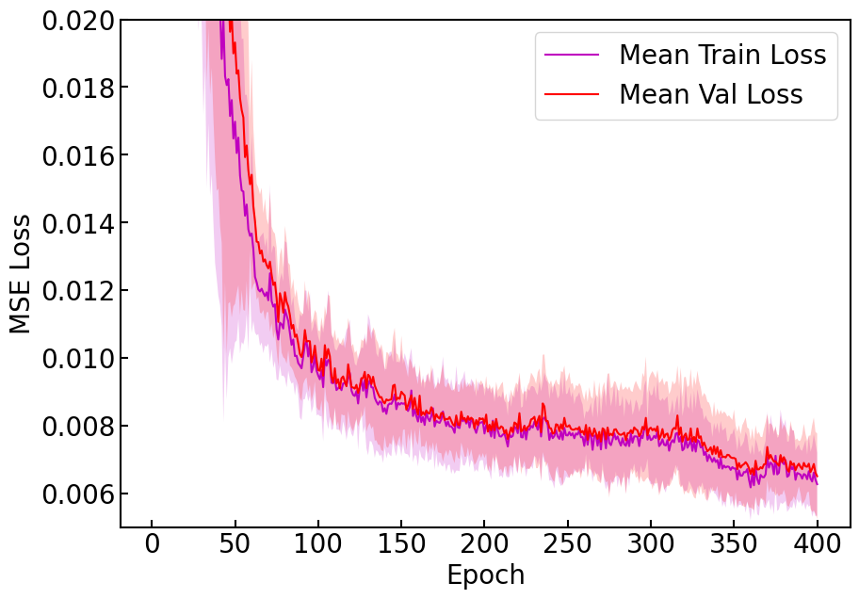
Baseline CNN — Loss vs Epoch

Slide 22
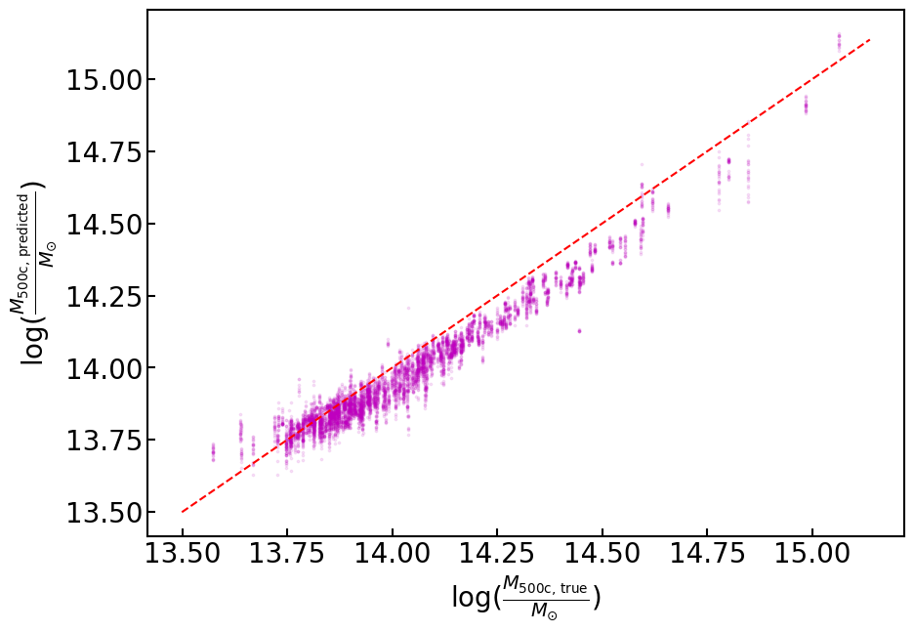
Baseline CNN — Scatter Plot

Slide 23
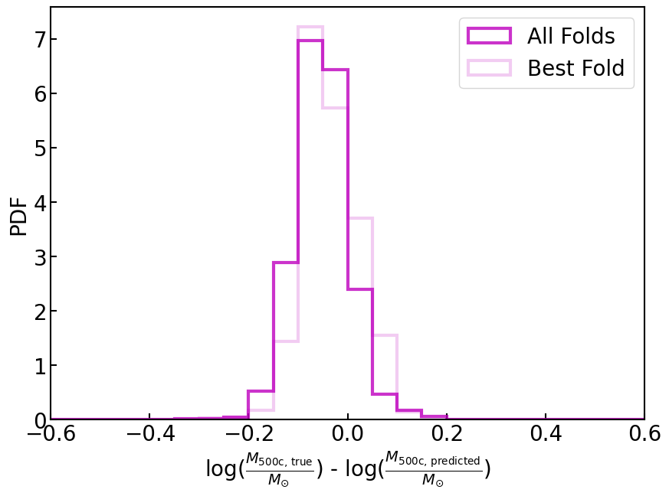
Baseline CNN — Residual Histogram
All folds:
bias = -0.0518 dex
scatter = 0.0558 dex
Best fold:
bias = -0.0342 dex
scatter = 0.0553 dex

Slide 24
Rotationally-Invariant CNN (RI-CNN) v1
Same architecture (same CNN model), but use 8 augmented image from a single image to derive a single prediction mass by pooling
Forces the model to learn from rotated / flipped images to effectively predict the mass by using all the augmented data to a shared weight.
How our RI models become rotationally invariant
D4 views: For each X-ray image, make 8 versions (0/90/180/270° + flips).
Shared backbone: Run all 8 through the same feature extractor.
Group pooling: Average or max-pool the 8 feature vectors → one representation that doesn’t change when the input is rotated/flipped.
Regressor: Predict mass from this pooled feature.
Note: The paper’s baseline CNN isn’t rotation-invariant (they only augment with rotations/flips)

Slide 25
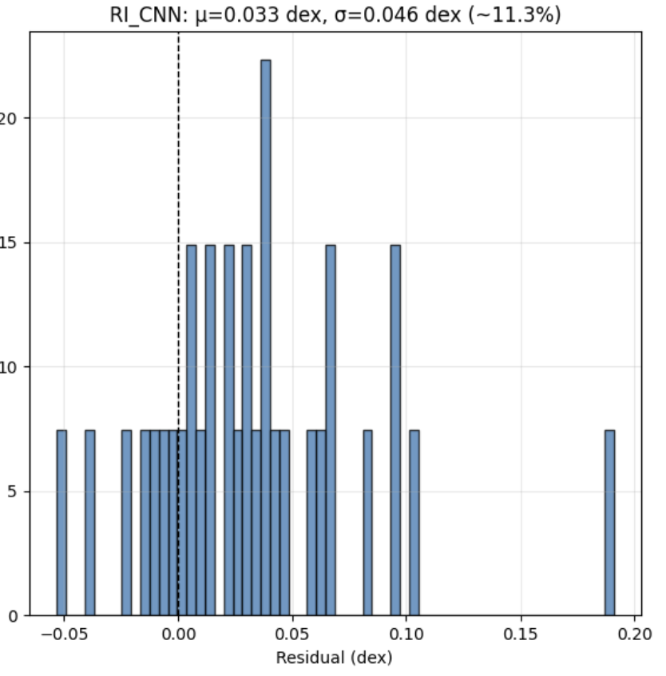
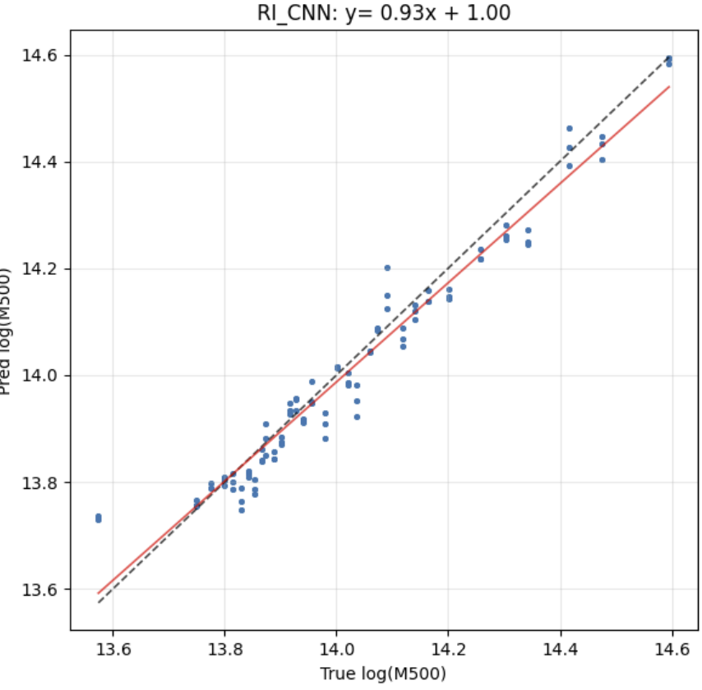
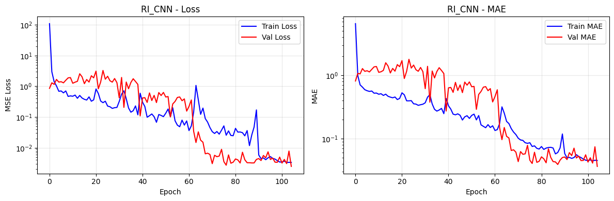
Rotation-Invariant CNN v1
orange - best fit
dotted black - perfect prediction

Slide 26
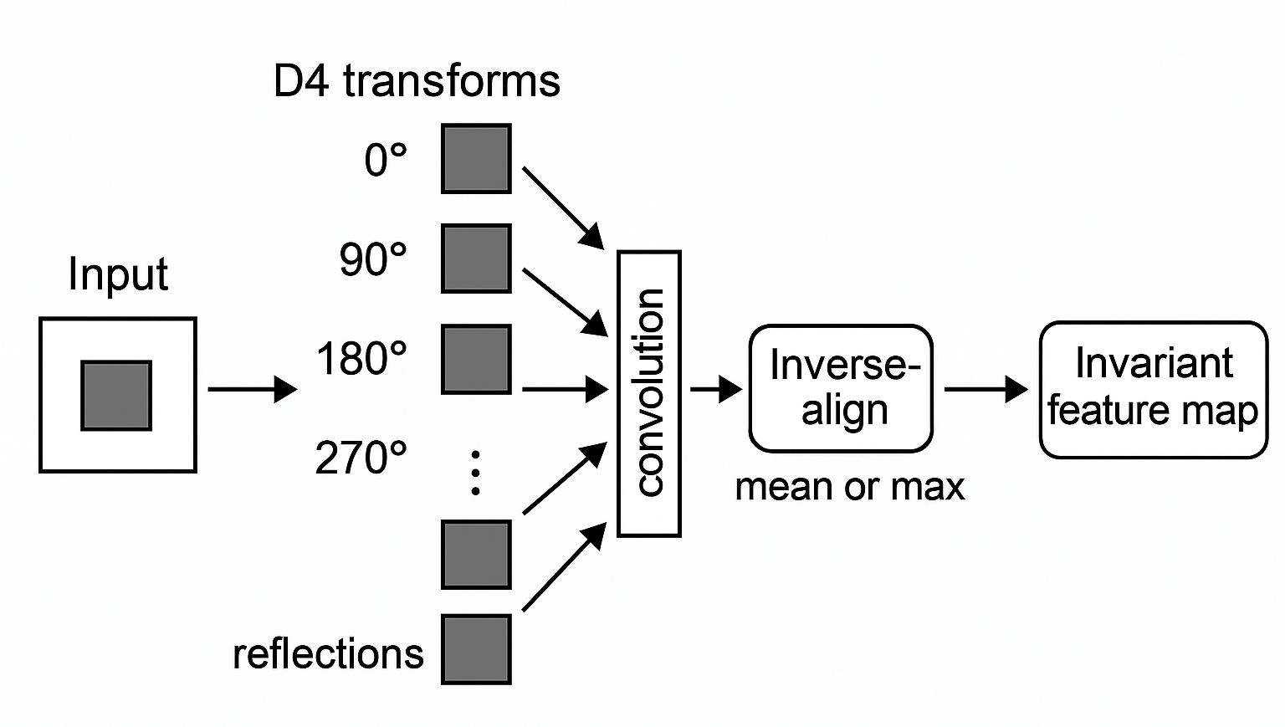
Rotation-Invariant CNN v2

Slide 27
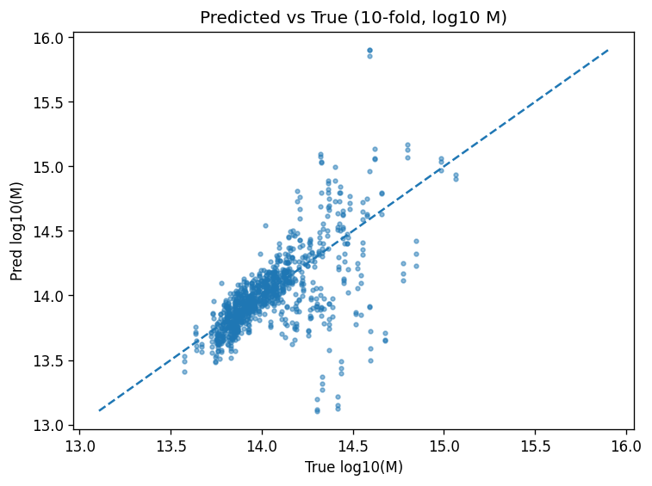
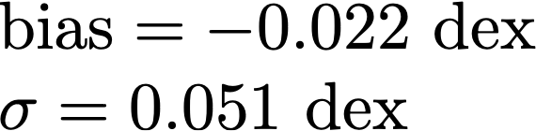
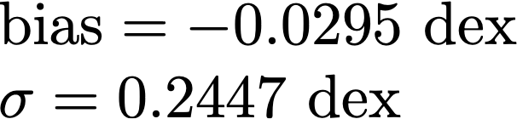
Rotation-Invariant CNN v2
Paper:

Slide 28
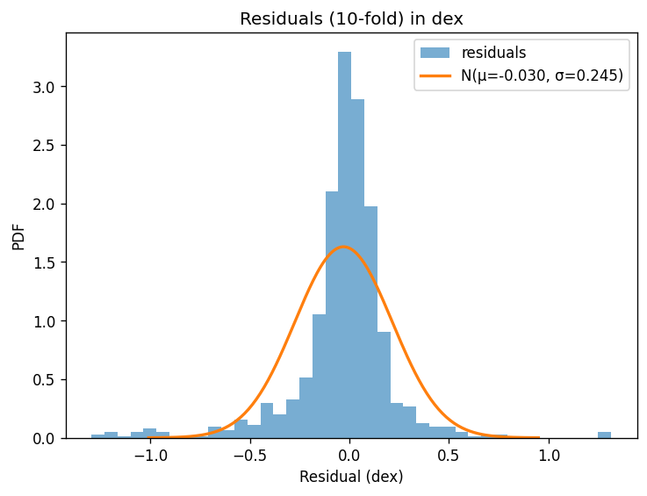
Rotation-Invariant CNN v2
Paper:

Slide 29
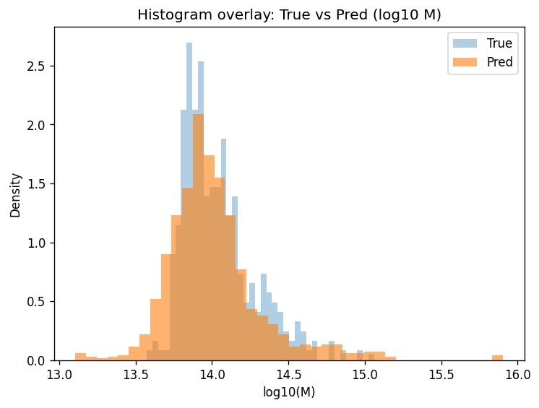
Rotation-Invariant CNN v2
Paper:

Slide 30
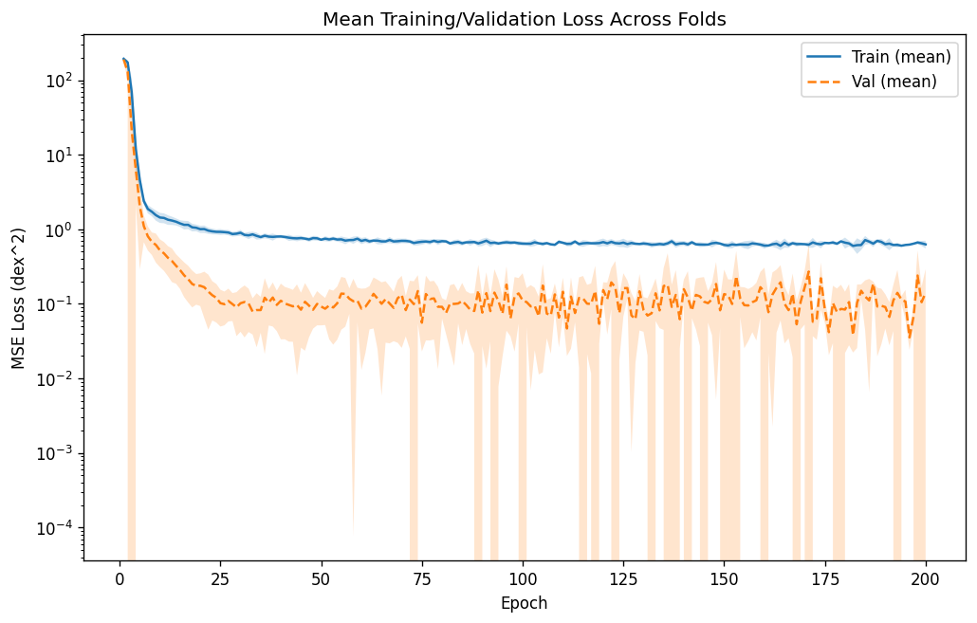
Rotation-Invariant CNN v2
Paper:

Slide 31
Discussion
Goal. Predict galaxy-cluster mass from mock X-ray images; reproduce paper; test a rotationally invariant CNN (RI-CNN).
Setup. Baseline CNN with rotations/flips as data augmentation; RI-CNN (two versions) with shared weights across transforms and pools outputs.
Findings. Baseline gives accurate, stable predictions (points close to the 1:1 line; small, centered residuals).
RI-CNN. Similar errors and correlation to baseline; no consistent improvement.
Why? Strong augmentation already teaches invariance; simple CNN captures most signal in these maps.
Cost. RI-CNN trains slower/heavier without clear accuracy gains.
Performance is saturated already by basic CNN based models with only small room for improvement

Slide 32
Limitations
Data size. Few unique clusters → limited diversity; bigger models tend to overfit.
Redundant invariance. Since augmentation already adds rotations/flips, RI-CNN has little headroom to improve.
Signal loss. Pooling over rotations can discard orientation cues (e.g., asymmetric substructure, merger features) that still correlate with mass, slightly capping RI-CNN gains.
Sim-to-real gap. Labels from mocks; noise/PSF/instrument differences may limit ceiling.
Tuning/budget. Minimal hyperparameter search; RI design choices (pooling) not deeply optimized due to long computation time.
Next steps. More clusters & realistic sims; continuous-rotation equivariant convs; multi feature fusion; uncertainty estimation and ensembles.

Slide 33
Thank You

Slide 34
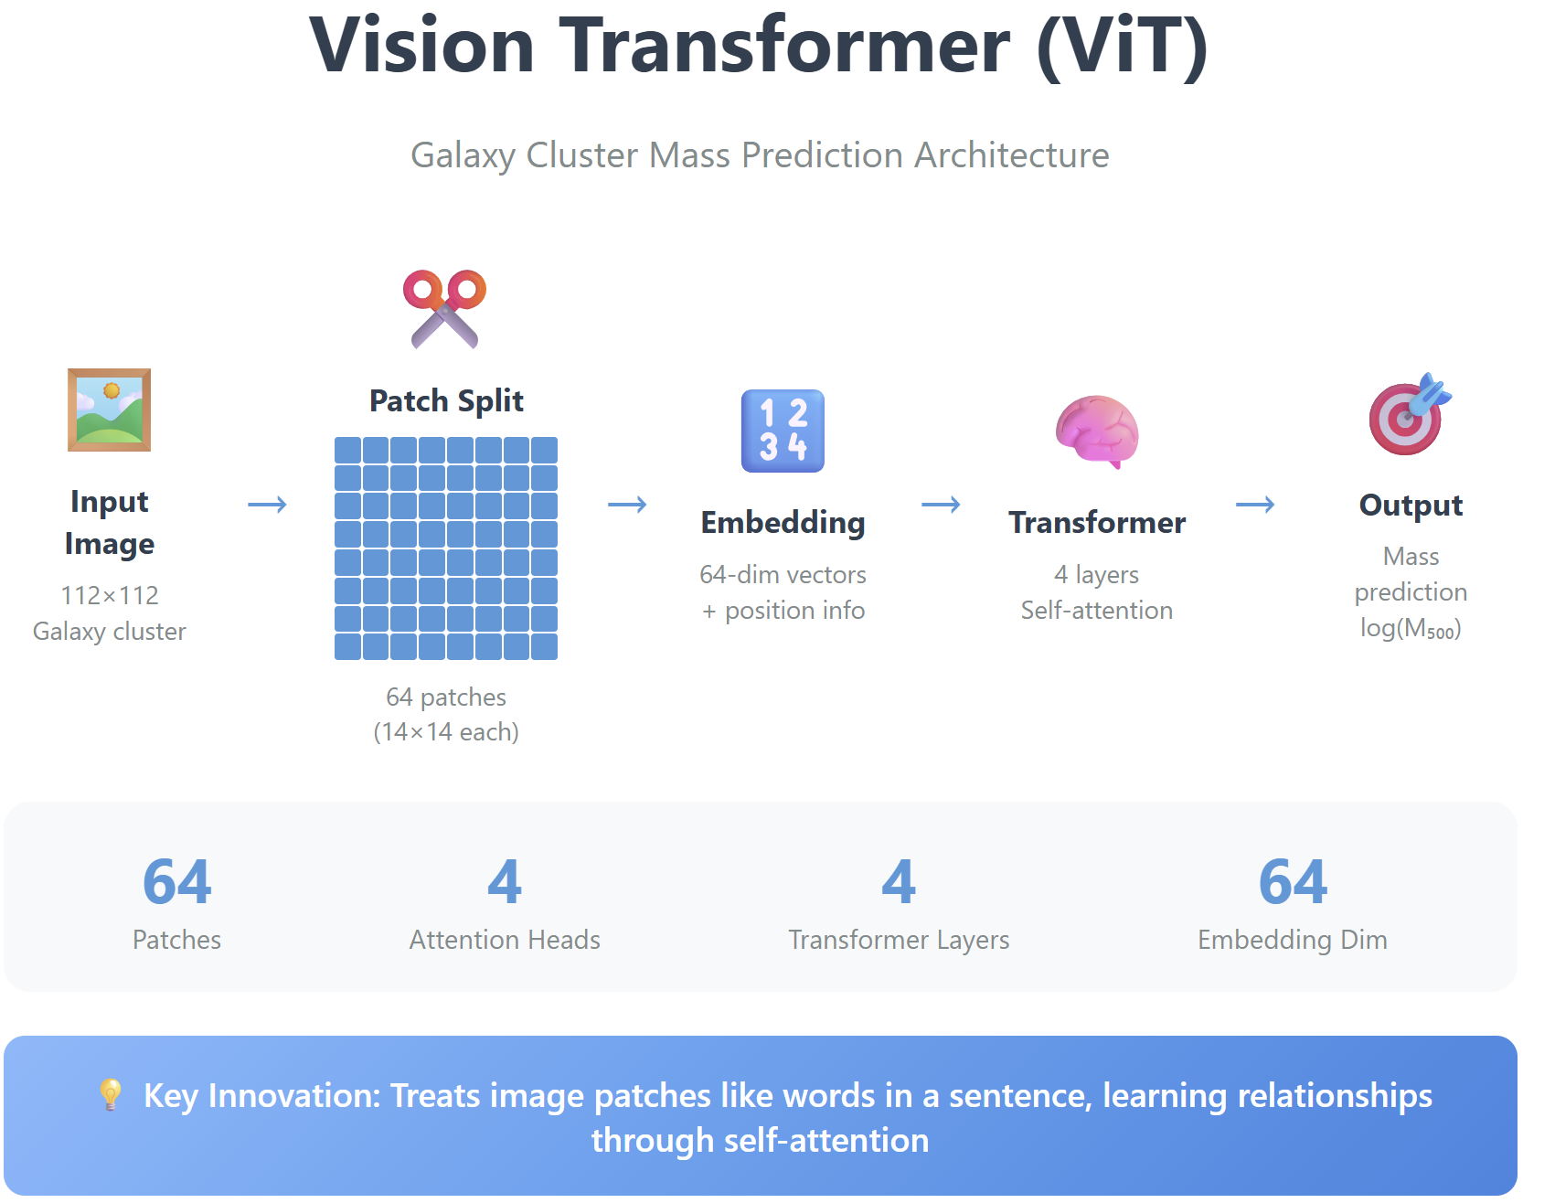
Models 3) Visual Transformer (ViT)
Image to Patches: Takes a 112×112 galaxy image and cuts it into 64 small patches (like cutting a photo into squares)
Convert to Numbers: Each patch becomes a list of 64 numbers, plus position information so the model knows where each patch came from
Learn Relationships: 4 transformer layers use attention to figure out which patches are important and how they relate to each other
Predict Mass: Combines all patch information to output a single number - the predicted galaxy cluster mass

Slide 35
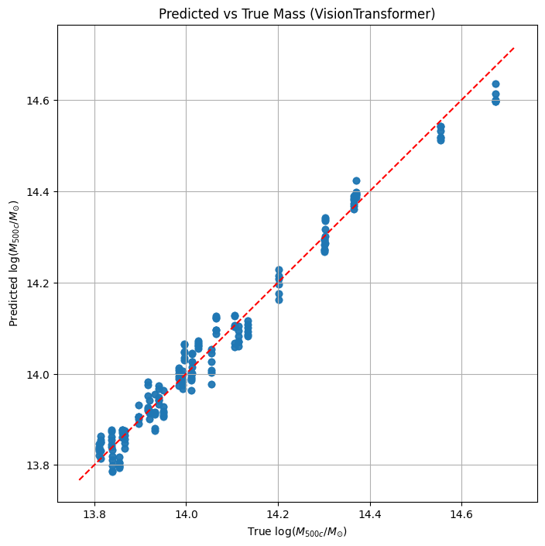
Models 3) Visual Transformer (ViT)

Slide 36
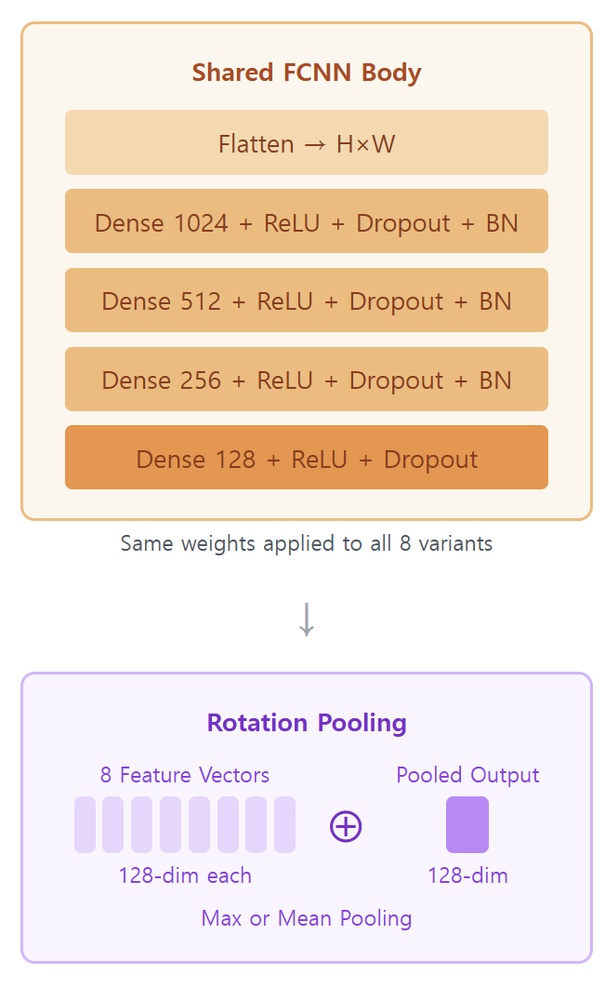
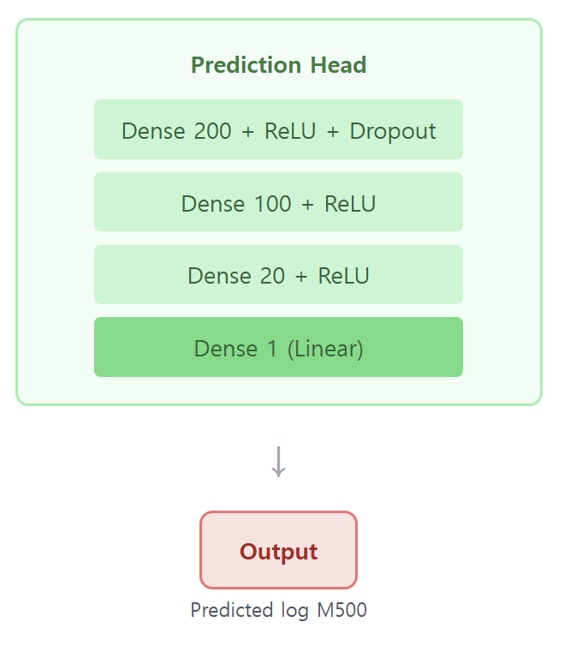
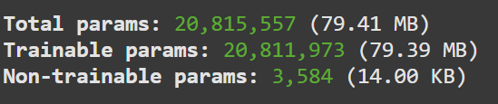
Models 4) Fully Connected Neural Networks (FCNN)

Slide 37
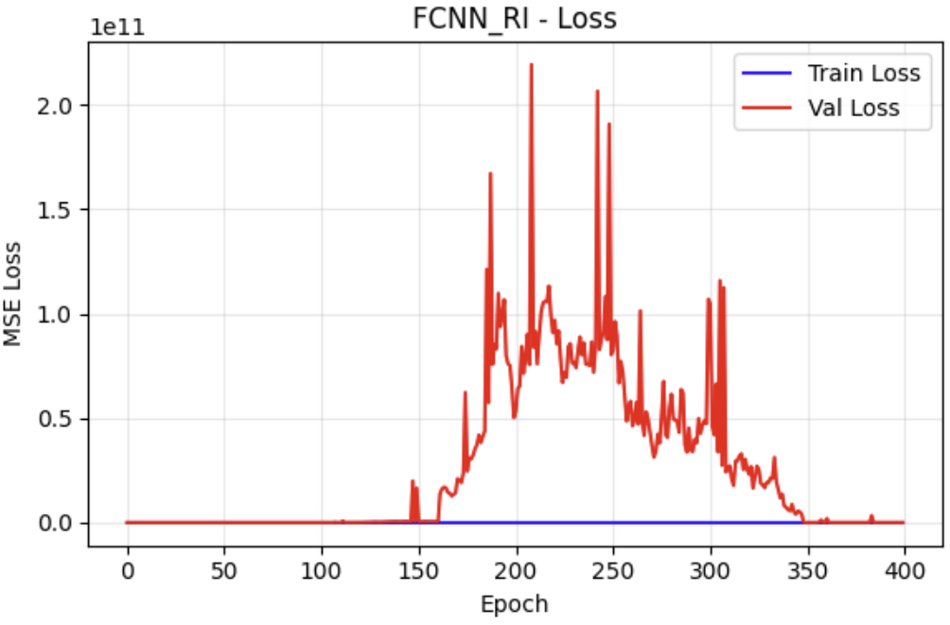
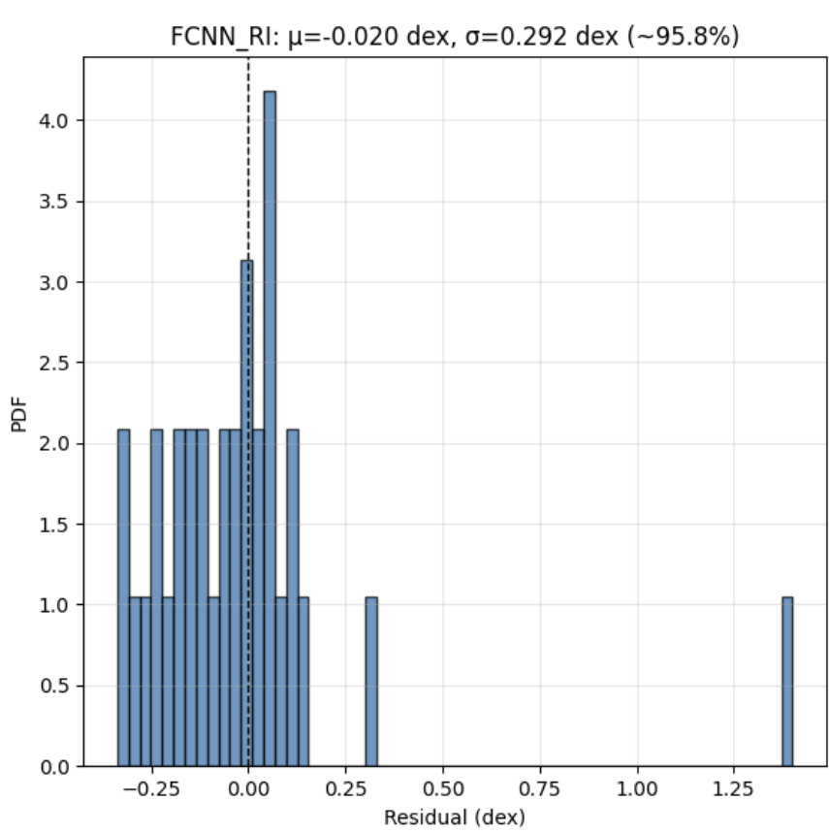
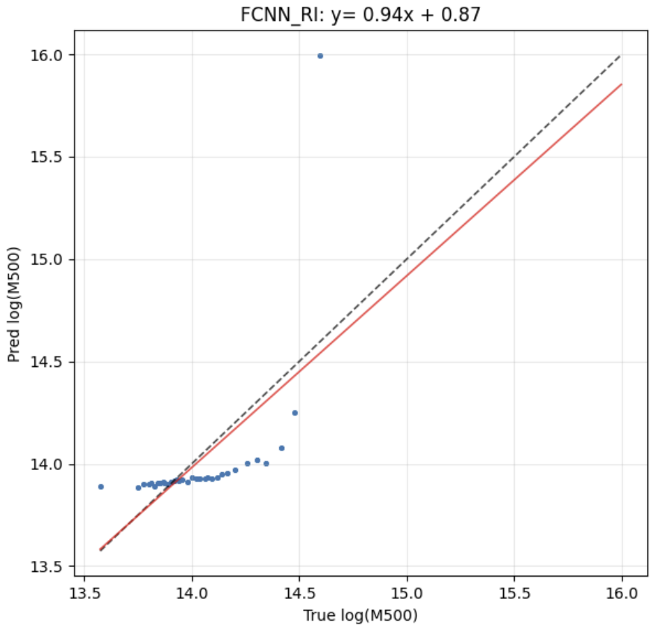
Models 4) Fully Connected Neural Networks (FCNN)

Slide 38
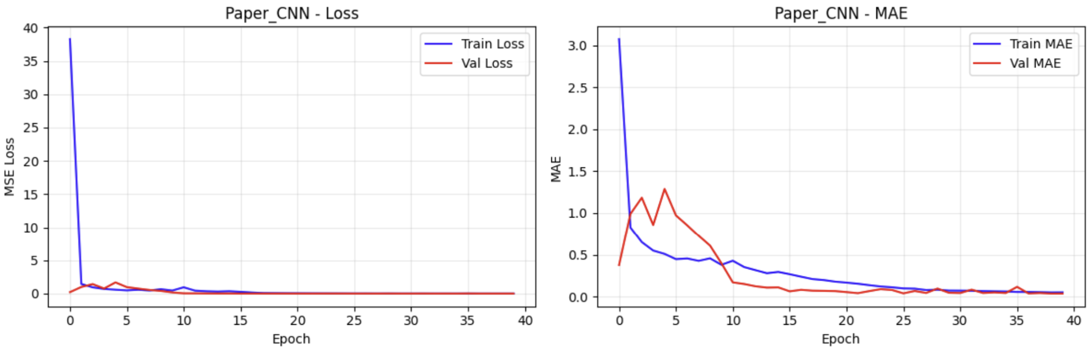
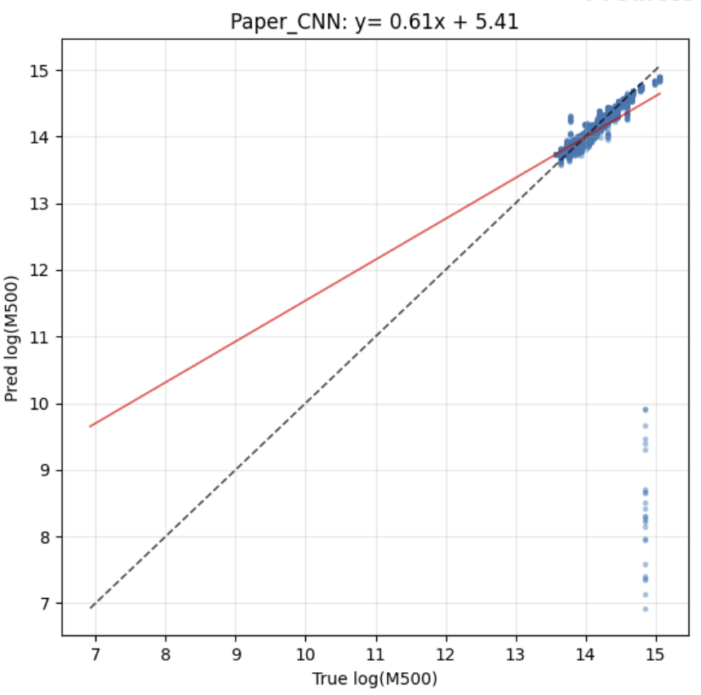
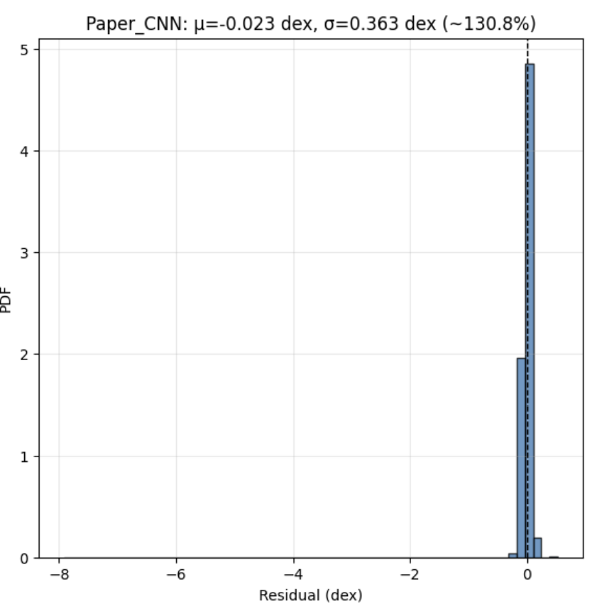
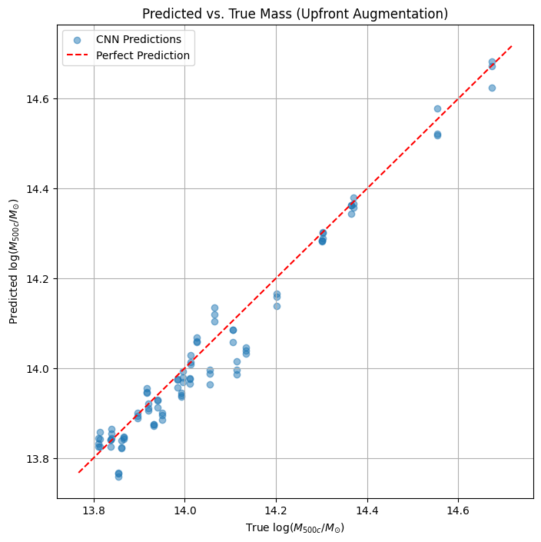
Models 1) Baseline CNN - ver1
random rotation

Slide 39
Models 3) CNN + Tree Based Regression
Input features (rotation-invariant): For each image, make 8 D4 views (4 rotations × flips), pass all through the same CNN body, then pool (mean/max) across the 8 outputs → one invariant feature vector per image.
Model: Train a tree-based regressor on these invariant features ; XGBoost (gradient-boosted trees).
Training target: log(M500c). Fit on train split; validate on held-out data.
Prediction: At test time, compute the same pooled features and feed them to the trained trees to get the mass estimate.
Handle non-linear patterns, fast to train

Slide 40
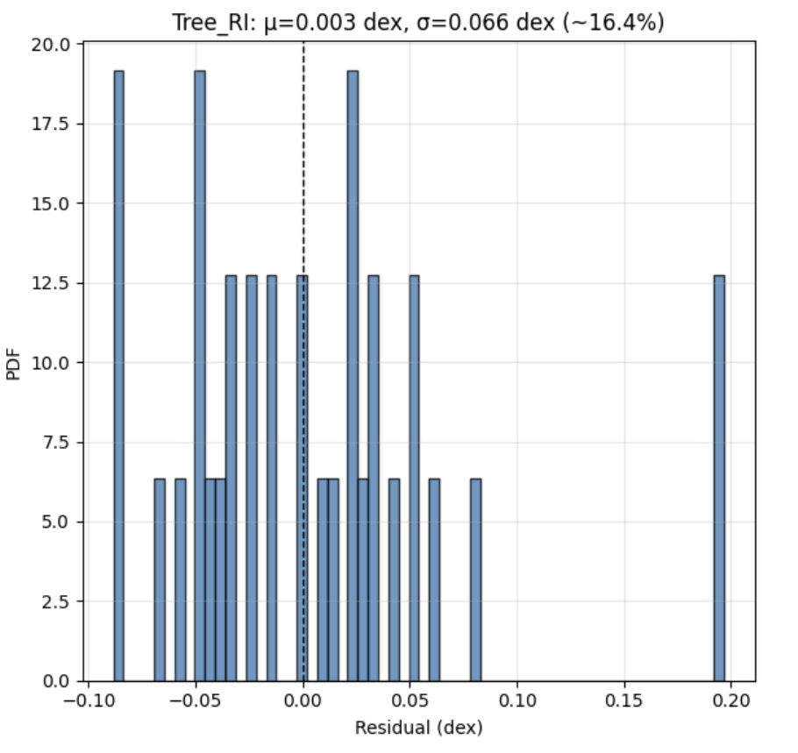
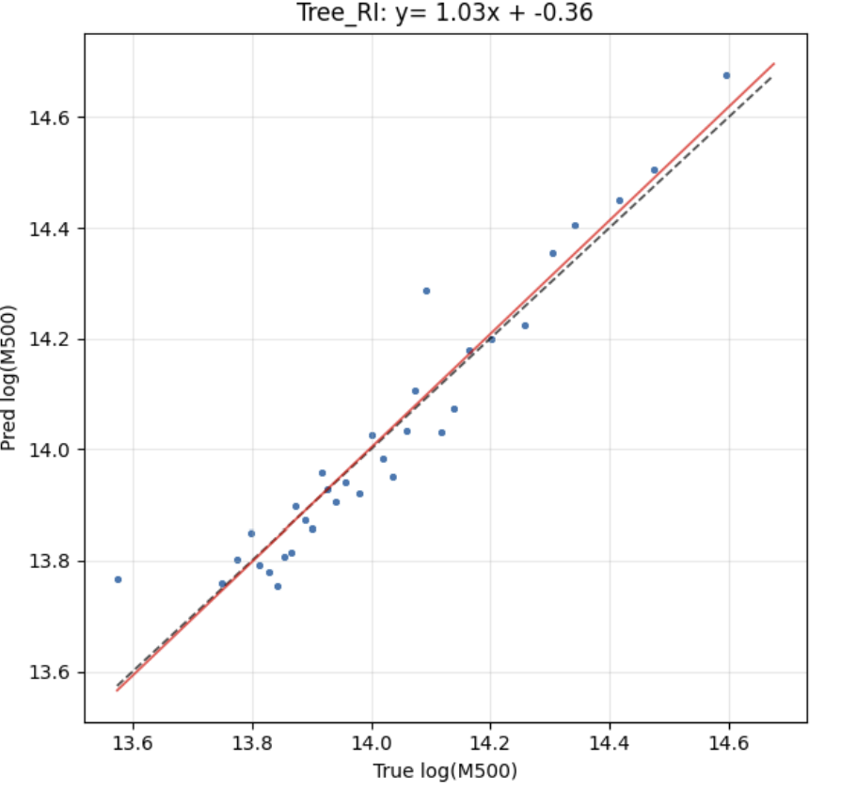
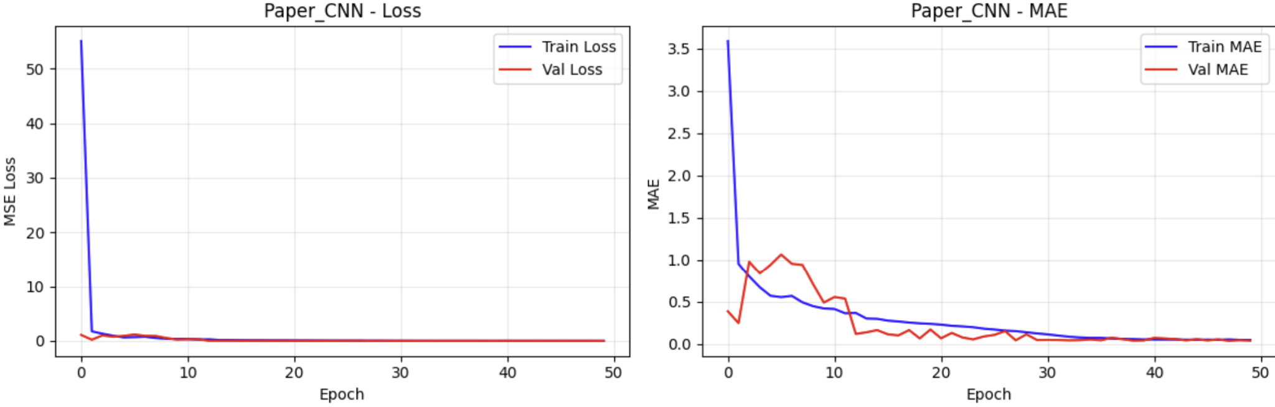
Models 3) CNN + Tree Based Regression

